Slide 1
Project CISAC-CISIN
October 6th 2016

Slide 2
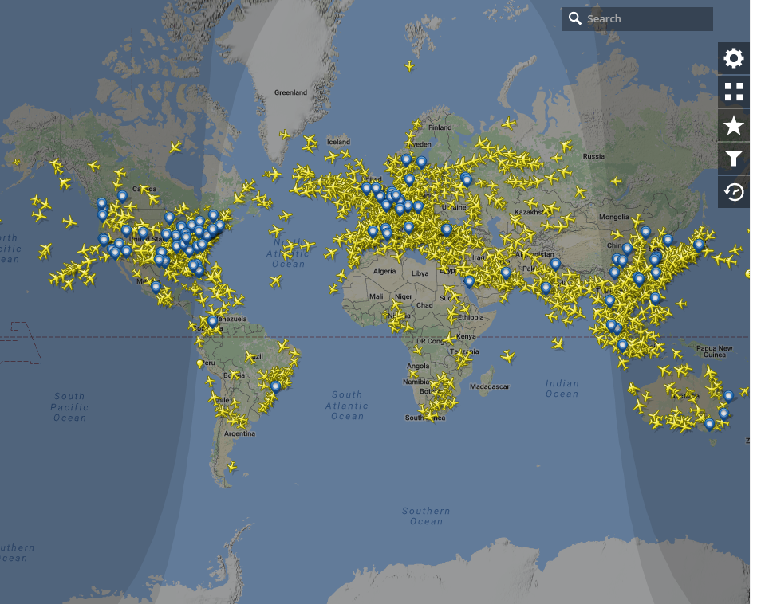

Presentation
Paulo Flores
Docteur en Sciences Appliques ULg 2006
Associate Professor at the University of Concepcion, Chile
Research focused on mechanics of materials (experimental)
  Materials formulation and manufacturing
  Mechanical solicitations
  Applications
Main subject: Study of the mechanical behavior of fiber reinforced polymers
  QS – Fatigue
  In-plane shear and damage
  Out-of-plane compression
  In-plane fracture
  Multi-scale analysis
  FE materials pa
  Parameters identification
  Etc …

Slide 3
Presentation

Slide 4
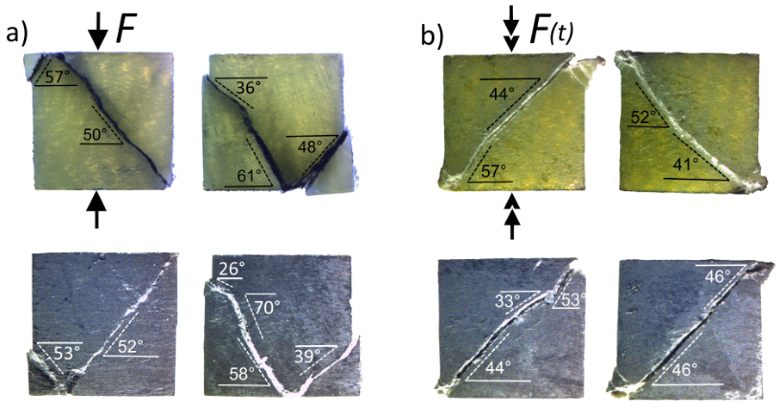
Presentation

Slide 5
Presentation

Slide 6
CISAC
In few words….
The project focus the prediction, by means of a FE code, of the effect of material strain rate sensitivity under impact loads
Objectives
To develop a model (from literature, rigorous theoretical and physical based, law’s material parameters linked to physical phenomena)
Model implementation in a FE code (home made and commercial)
Validation from literature and industrial experience data
To define a protocol for material parameters identification

Slide 7
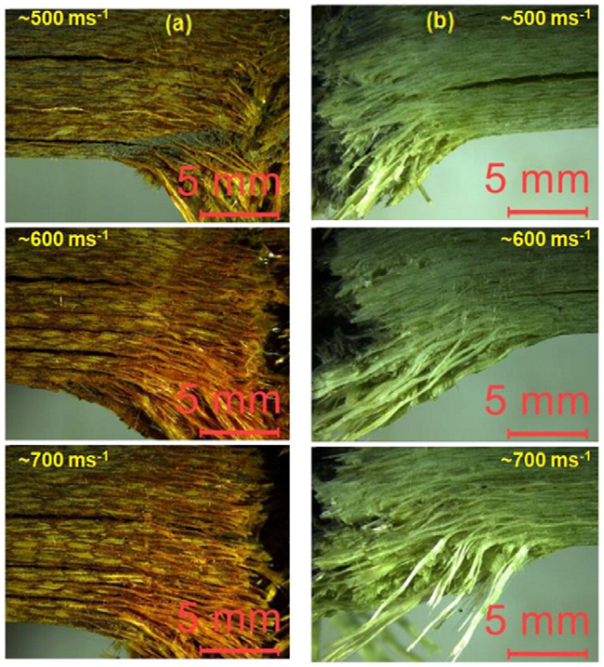
Strain rate sensitivity?
Failure caused by impact at various velocities. a) E-glass/phenolic, b) E-glass/epoxy. [Reddy et al. 2016]

Slide 8
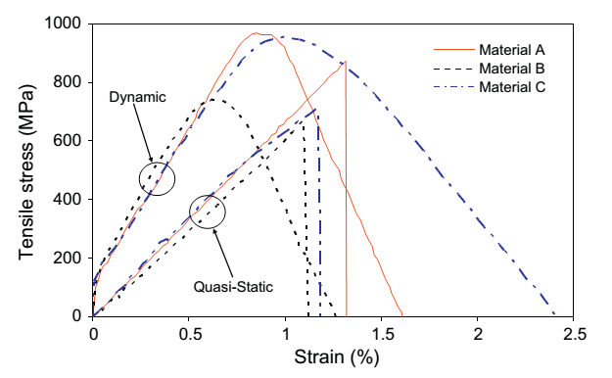
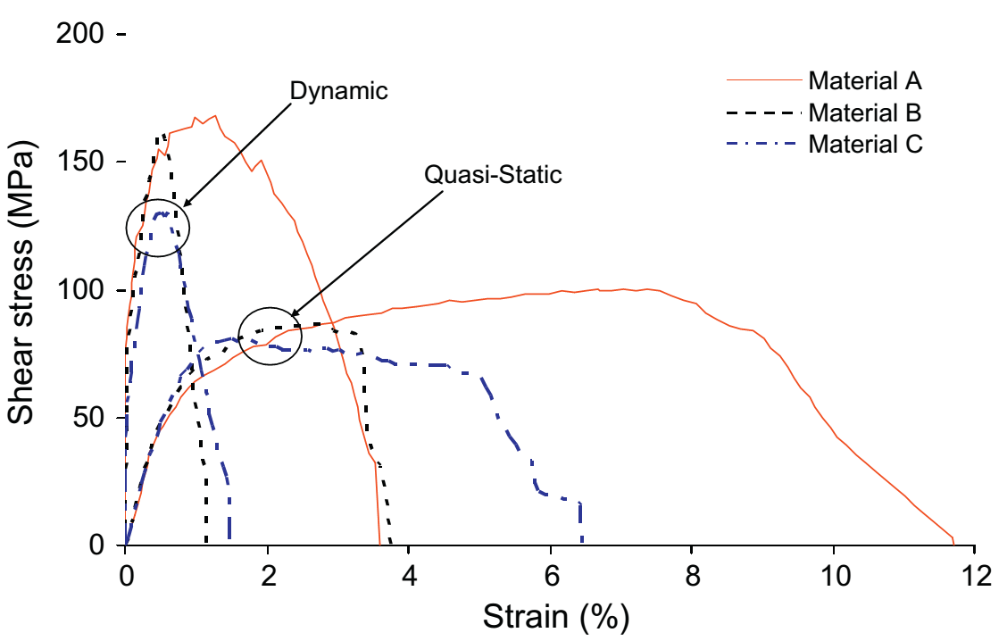
Strain rate sensitivity?
Stress-strain curves for 3 materials. A: Carbon-epoxy prepreg, plain weave, B: Carbon-epoxy prepreg, 2x2 twill, C: Carbon-BMI prepreg, 8 harness satin), in a) tensile and b) shear loading. [Foroutan et al. 2013]
YES !!! Matrix dependence (off-axis)
It is reported that carbon and glass fibers are not strain rate sensitive
Chen and Morozov, Comp. Struct. 148 (2016).

Slide 9
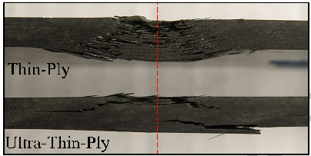
Material influence on impact behavior
Weave and binders
Pockets
Voids
Ply thickness
TP: shear failure in all the laminate, UTP brittle failure due to tensile and compressive failure at top and bottom. E-glass/Epoxy. [Wagih et al. 2016]

Slide 10
Model
Must take into account several failure mechanisms and the strain rate sensitivity
In general it must count with:
Orthotropic linear elastic behavior
Plasticity and hardening
Strain rate effects
Prediction of damage initiation and propagation
Modelling post failure behavior

Slide 11
Model

Slide 12
Testing

Slide 13
Testing

