Slide 1
MOCOMAC
29/04/2021
Gabriel Tanaka Nunes

Slide 2
Agenda
Context
Importation of Marc-Digimat-FE models to Metafor
Cohesive Zone Model
Random generation of spatial variability
Parameter study of the cohesive law
Plate with a hole test case
Reason of differences between structured mesh and unstructured mesh
Continuous Damage Model

Slide 3
Context
MOCOMAC activities since last meeting

Slide 4
Context
Two distinct approaches to model the microscopic scale of Ceramic Matric Composites (CMC’s)
Modeling the progressive cracking of the matrix is a key aspect of modeling the behavior of CMC’s
Two modeling strategies to be tested and compared
Cohesive zone model (CZM):
Cracking takes place in the interface of the finite elements
To be developed using Marc-Digimat-FE
The mesh is split when a given criterion is met
A cohesive element is created connecting the nodes that have been doubled and separated
The cohesive element is damaged as a function of the normal and tangential separations
Continuous damage model (CDM):
The cracking is considered by degrading the finite elements properties
To be developed using Metafor
Test existing CDM models in Metafor for their capability of being used to model CMC’s
Improve importation of models generated by Marc-Digimat-FE to Metafor

Slide 5
Importation of Marc-Digimat-FE models to Metafor

Slide 6
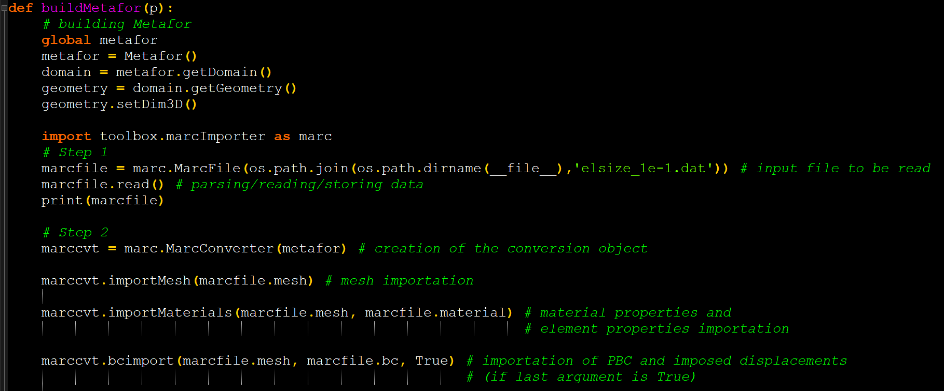
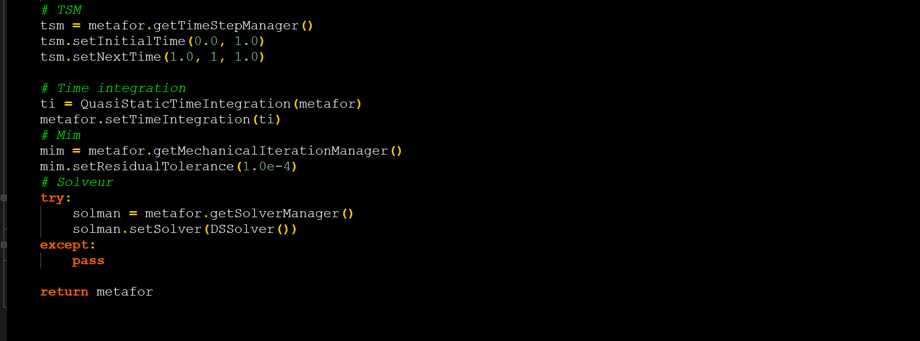
Importation script
Added capabilities
marcImporter.py was already capable of:
Importing nodes and node sets
Importing elements and element sets
Importing material properties and element properties
New capabilities:
Importation of periodic boundary conditions
Servo links (Marc syntax) are imported as LinearConstraintLagMult3DElement (Metafor syntax)
Importation of imposed displacements
Verbose Boolean to enable printing importation info for debugging (Default=Disabled)
Very few input data must be user defined when importing a Marc-Digimat-FE input into Metafor
Timestep manager
Time integration
Mechanical iteration manager
Solver
History curves to be saved

Slide 7
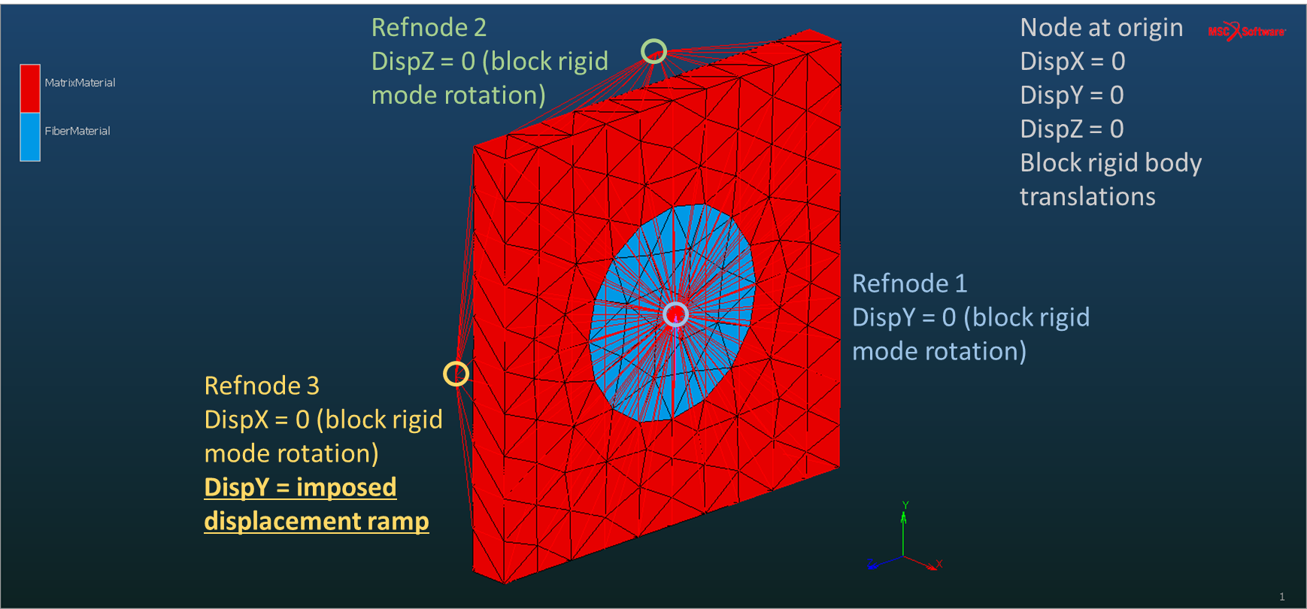
Verification of the importation script
Periodicity conditions
$$U_{Refnode2}=U_{A}−U_{B}$$
$$V_{Refnode2}=V_{A}−V_{B}$$
$$W_{Refnode2}=W_{A}−W_{B}$$
Description of the validation model: single fiber loaded in shear
A
Convergence analysis of a model with periodic boundary conditions
Shear loading
Different mesh sizes
Transversely isotropic elastic fiber
Isotropic elastic matrix
B

Slide 8
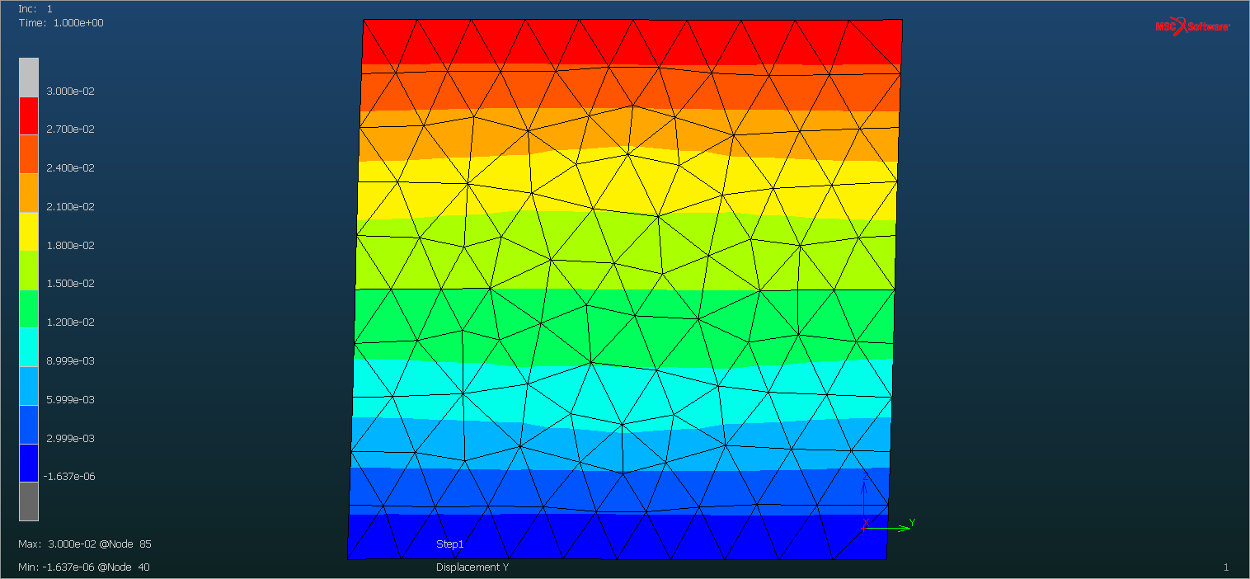
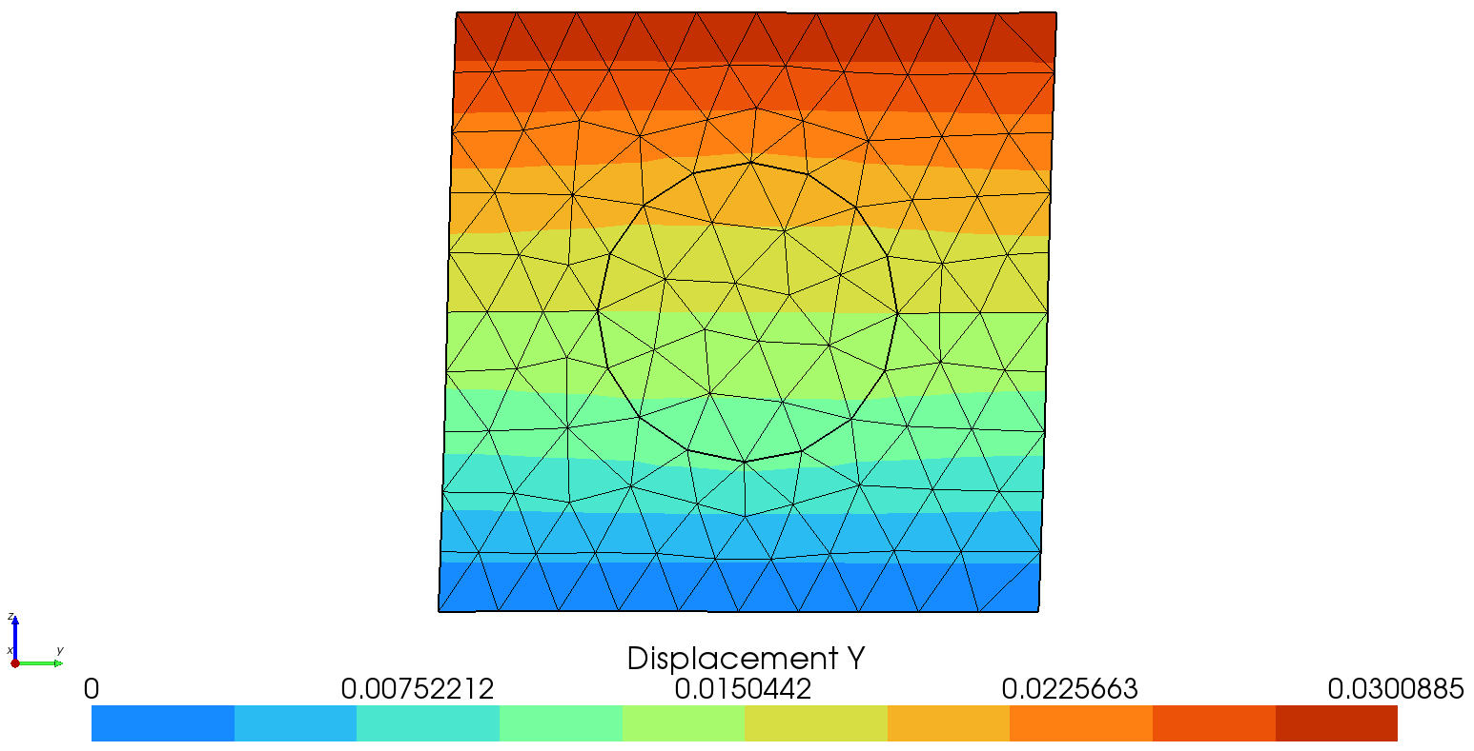
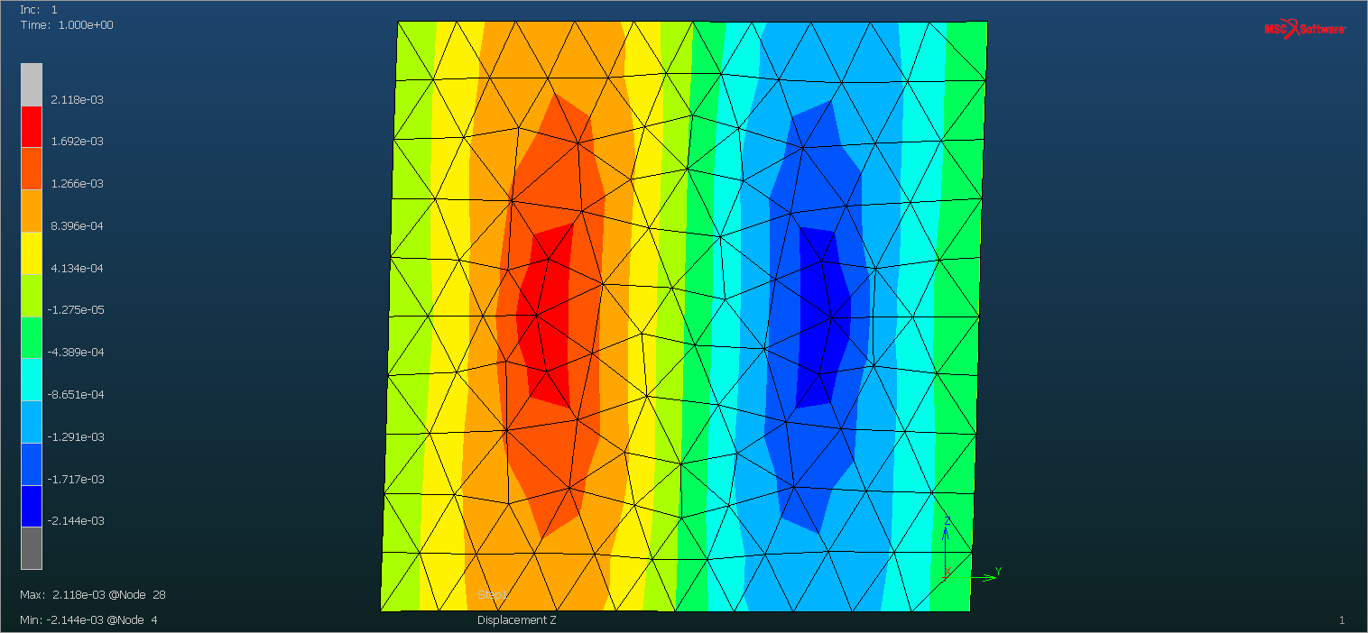
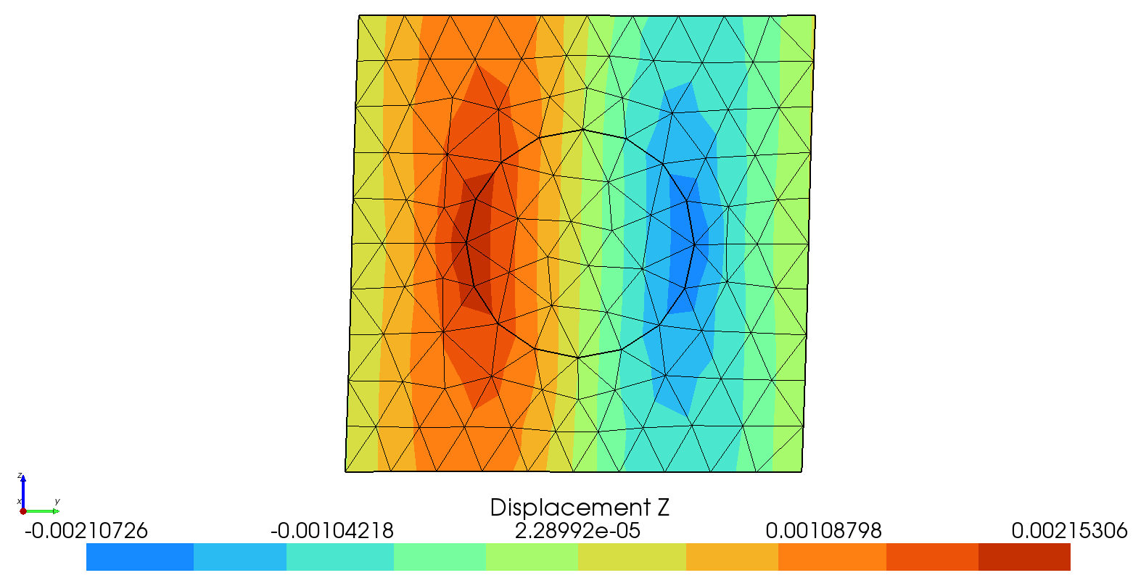
Verification of the importation script
Comparison of displacement fields
Marc
Metafor
Max: 3.0e-2
Max: 3.00885e-2
Displacement Y
Min: -1.637e-6
Min: 0
Max: 2.118e-3
Max: 2.15306e-3
Displacement Z
Min: -2.144e-3
Min: -2.10726e-3

Slide 9
Macro modulus convergence
$Shear modulus= \frac{Shear stress}{Shear strain}= \frac{F/A}{{DispY}/{LZ}}$

Slide 10
Cohesive Zone Model

Slide 11
Random generation of spatial variability

Slide 12
Material variability
CMC’s, like other materials, present defects:
Porosity
Microcracks
In order to account for this variability, a randomly generated Weibull field can be used
The mesh split criterion is based on the strength values of this table
A C++ code was developed to allow for the creation of randomly generated Weibull fields in the format of a table that can be interpreted my MSC Marc
The table references a strength value to coordinates of the undeformed mesh
The table can be 1D, 2D or 3D
If an integration point does not coincide with a point referenced in the table, its strength value will be interpolated from the table
The user can choose:
The number of points in each direction – Allows the user to control the space correlation
The scale factor (a.k.a. scale parameter)
The Weibull modulus (a.k.a. shape parameter, Weibull slope)
Probability density function of a Weibull random variable:
a: Weibull modulus
b: Scale factor

Slide 13
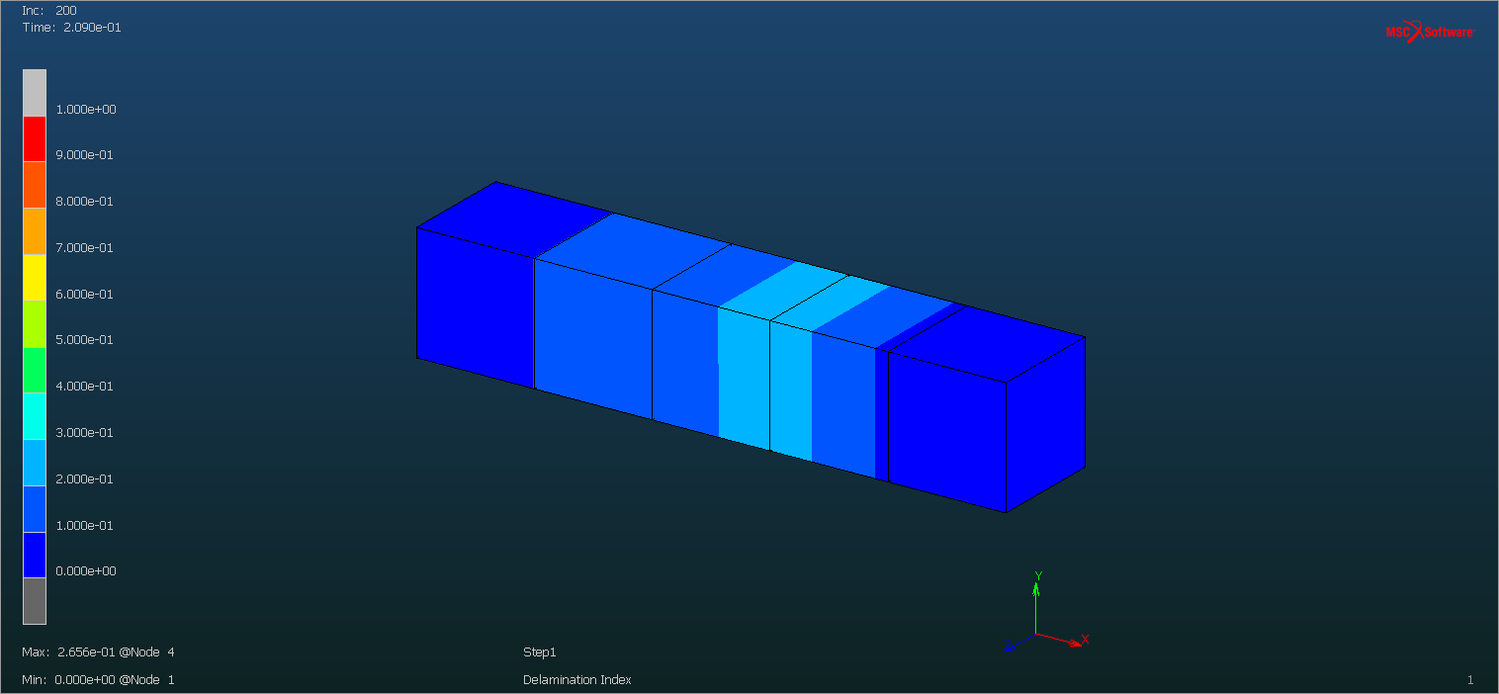
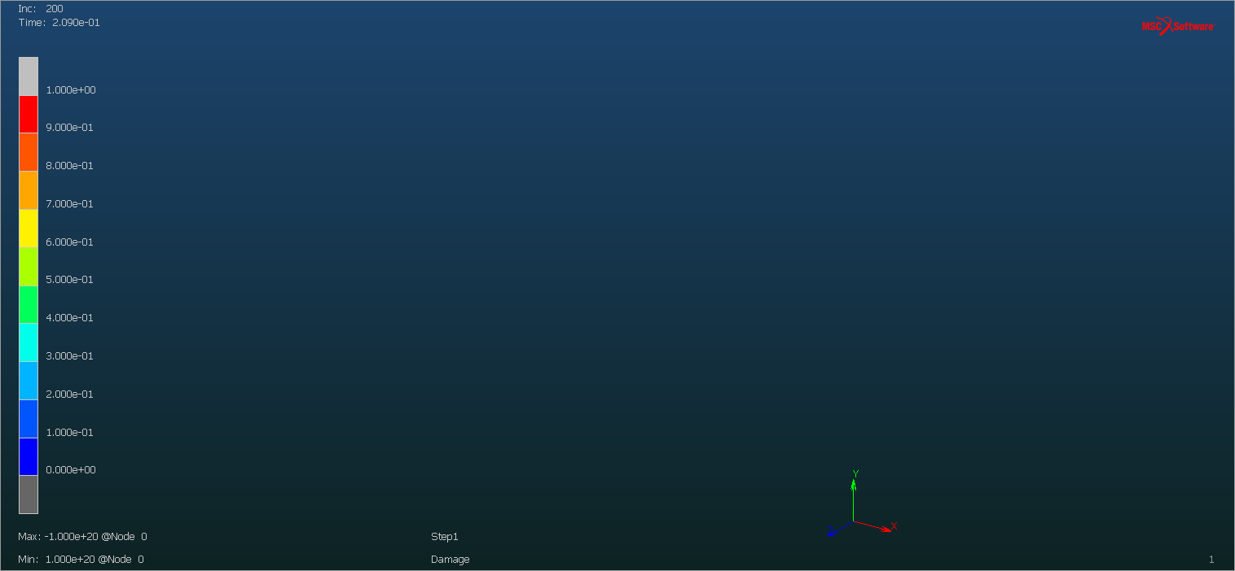
Example
Mesh split criterion:
$${\left(\frac{σ_{n}}{S_{n}}\right)}^{2}+{\left(\frac{σ_{t}}{S_{t}}\right)}^{2}>1$$
$S_{n}$= $S_{t}=Table value$
Table randomly generated:
Mesh split index
Coordinate X of undeformed configuration | Strength
0.000000000000000+0 | 4.113229773088400+0
1.000000000000000+0 | 5.316419139531700+0
2.000000000000000+0 | 4.955720642998400+0
3.000000000000000+0 | 3.276985760423600+0
4.000000000000000+0 | 5.997957450353900+0
5.000000000000000+0 | 5.802563060654900+0
Weakest point of the table
Damage of cohesive elements
When mesh split index = 1:
Mesh is split
Cohesive element is inserted and connects the faces that have been split

Slide 14
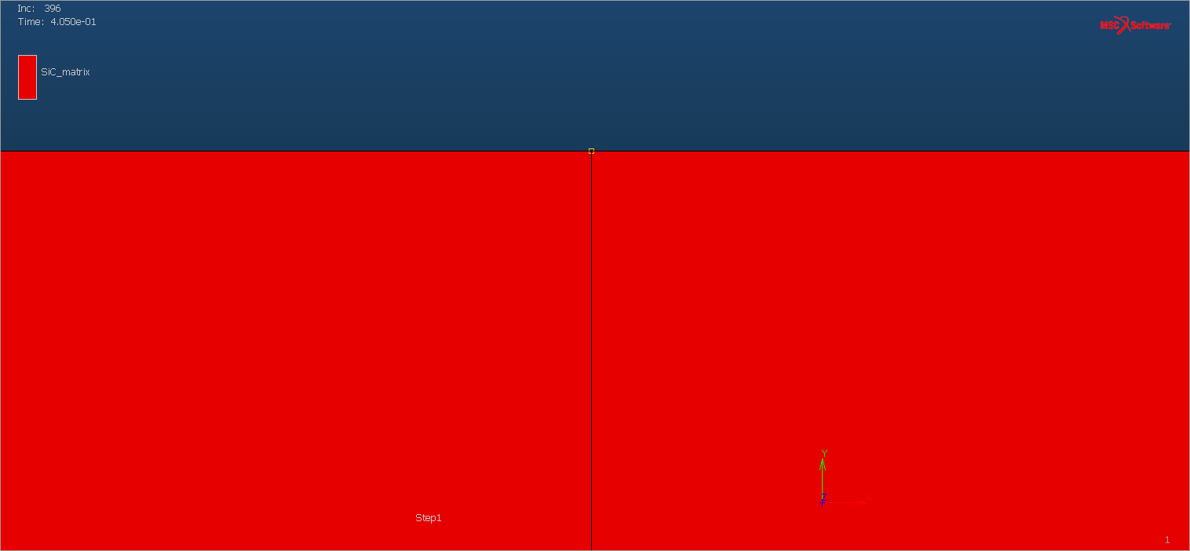
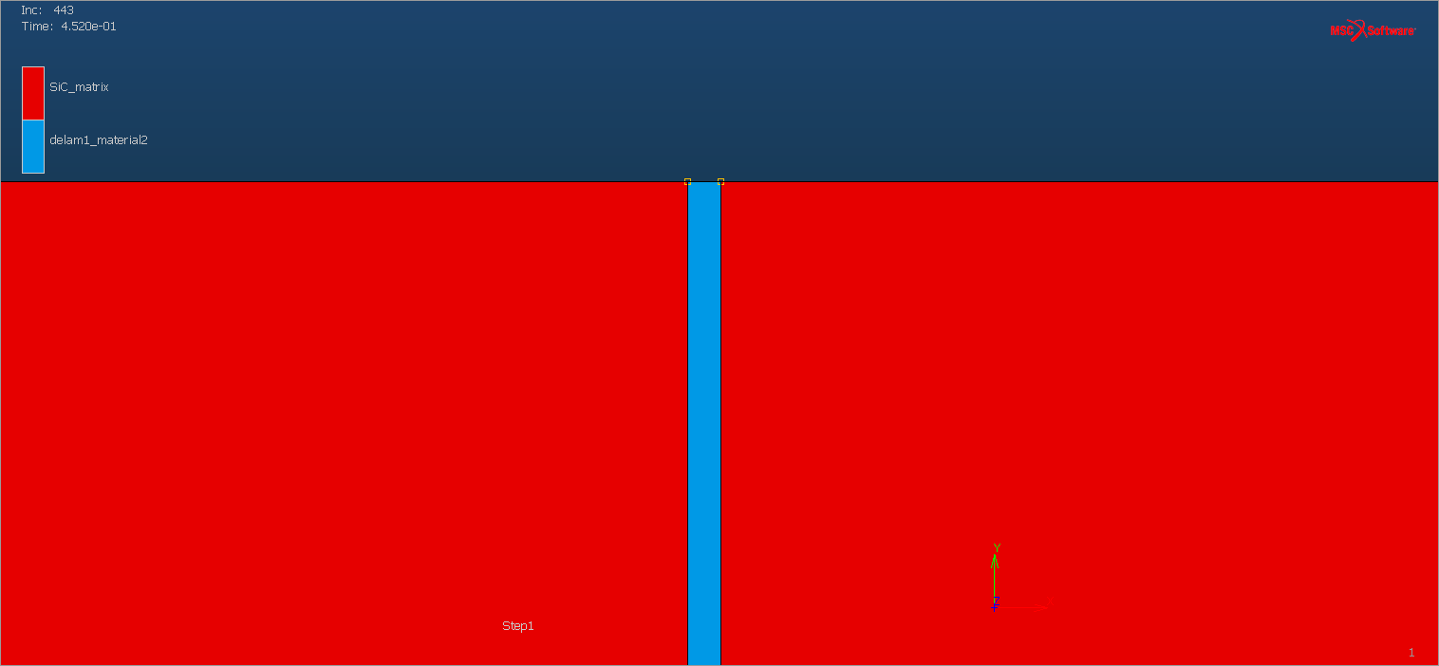
Detail of mesh split + insertion of cohesive element
Before mesh split criterion is met
After mesh split and insertion of cohesive element

Slide 15
Parameter study of the cohesive law

Slide 16
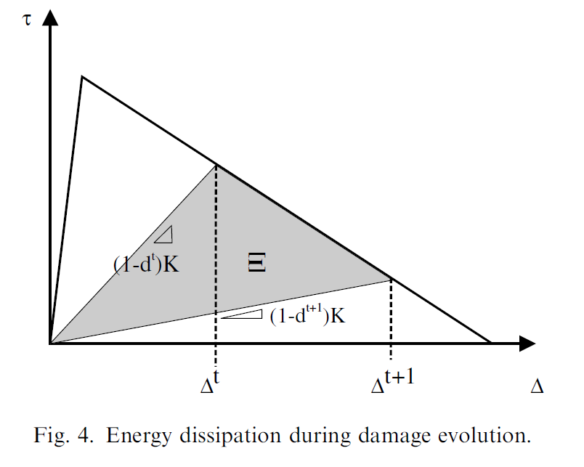
Turon cohesive law parameters
K = stiffness of the cohesive element [stiffness/length]
Mode I critical stress
Mode II critical stress
Mode I fracture energy
Mode II fracture energy
Timestep to be used when damage of cohesive element is evolving
Turon, A., Camanho, P. P., Costa, J., & Dávila, C. G. (2006). A damage model for the simulation of delamination in advanced composites under variable-mode loading. Mechanics of Materials, 38(11), 1072–1089. https://doi.org/10.1016/j.mechmat.2005.10.003

Slide 17
Model used for the parameter analysis
Same as previous example
Five hexahedral elements
A strength table is used by mesh split criterion
The weakest point of the table is where the mesh is split, and a cohesive element is inserted
In this case, the failure occurs by mode I only

Slide 18
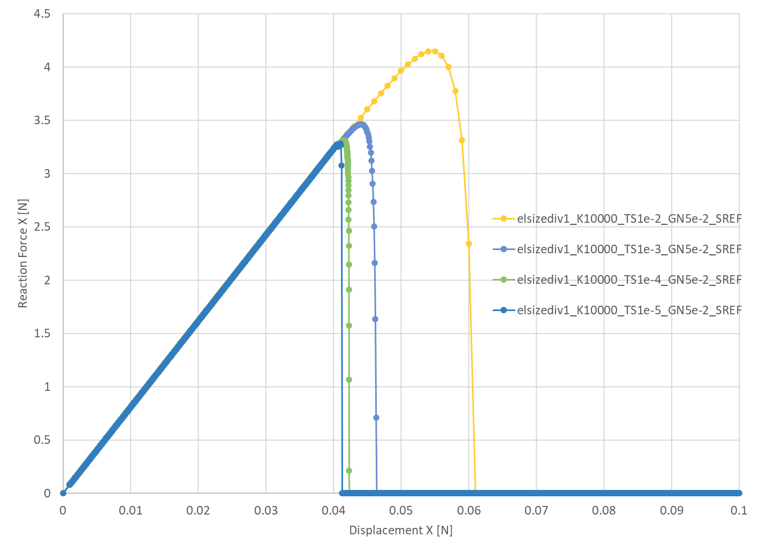
Timestep analysis
The time discretization have a major impact on a model with this formulation of cohesive zone.
This behavior is related to the explicit scheme used to compute the damage of the cohesive element
A timestep convergence study is required to find the optimal timestep. The objective is to find the largest minimal increment that provides a converged behavior.

Slide 19
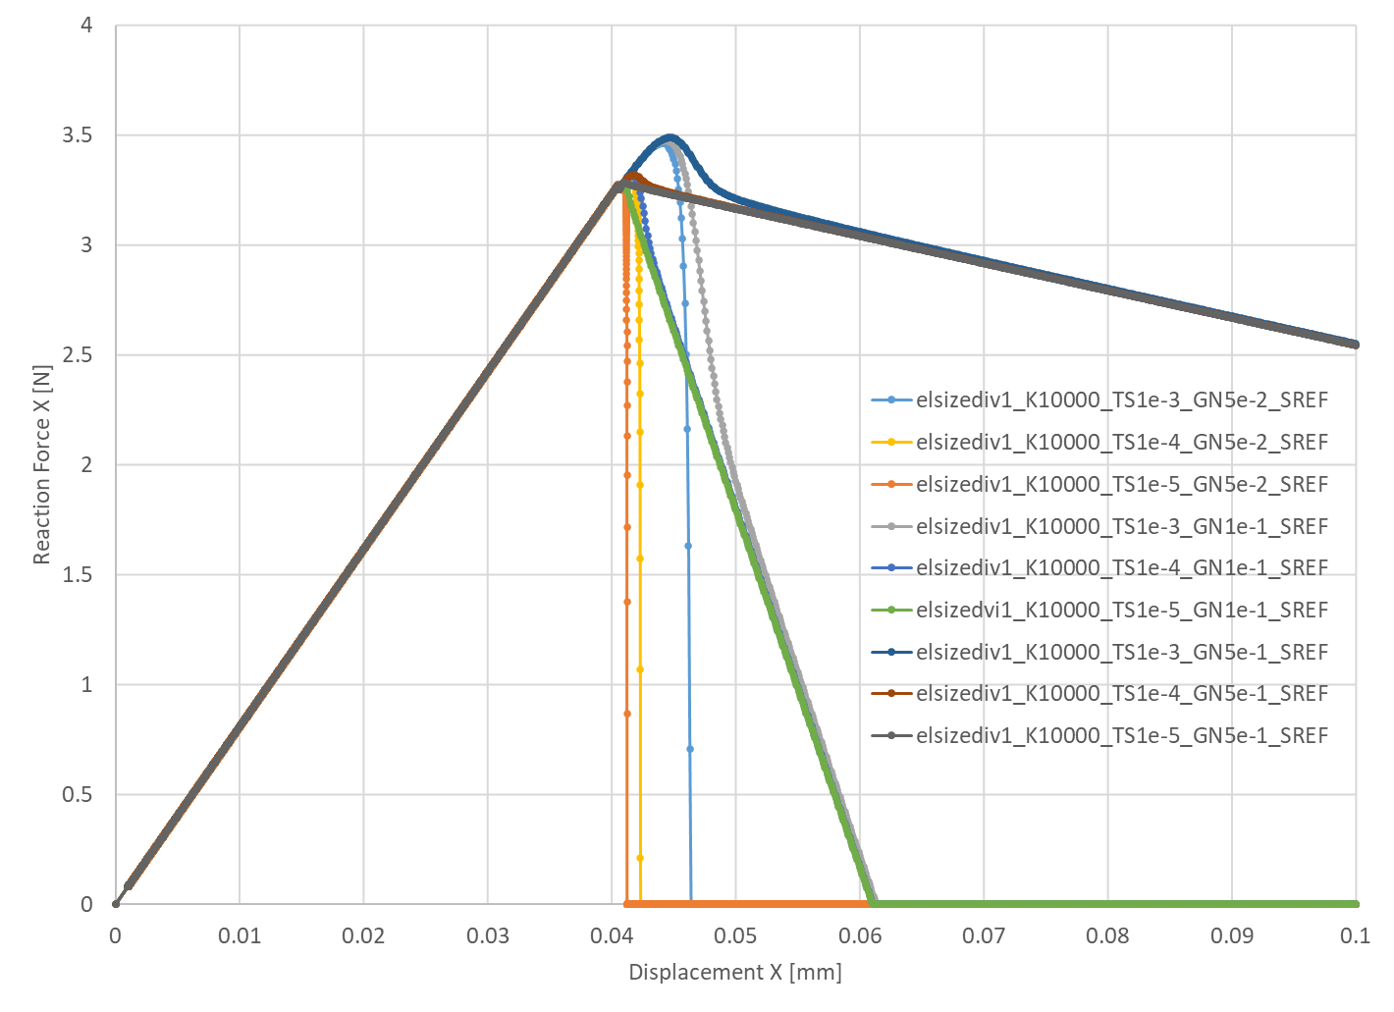
Mode I energy analysis
With a larger mode I energy, the damage evolves slower, requiring less timestep saves in order to capture the damage evolution
The timestep convergence happens for different mode I energy values

Slide 20
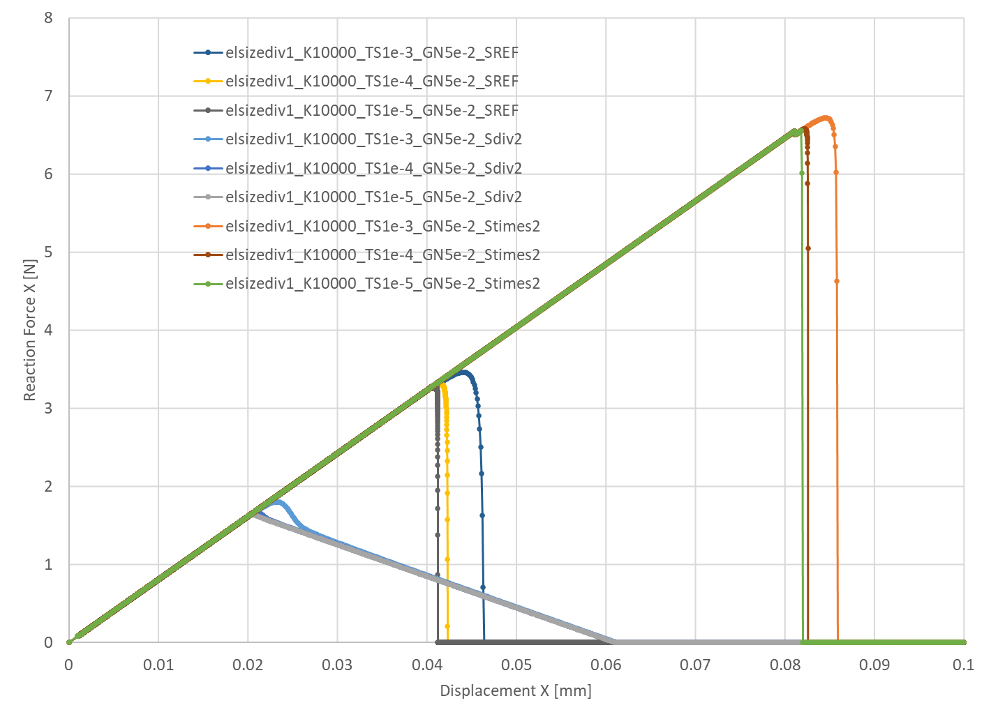
Strength analysis
An increase in the strength table values results in a more abrupt damage
More timesteps are needed in order to capture the gradual evolution of damage
The timestep convergence happens in a similar way for different strength values

Slide 21
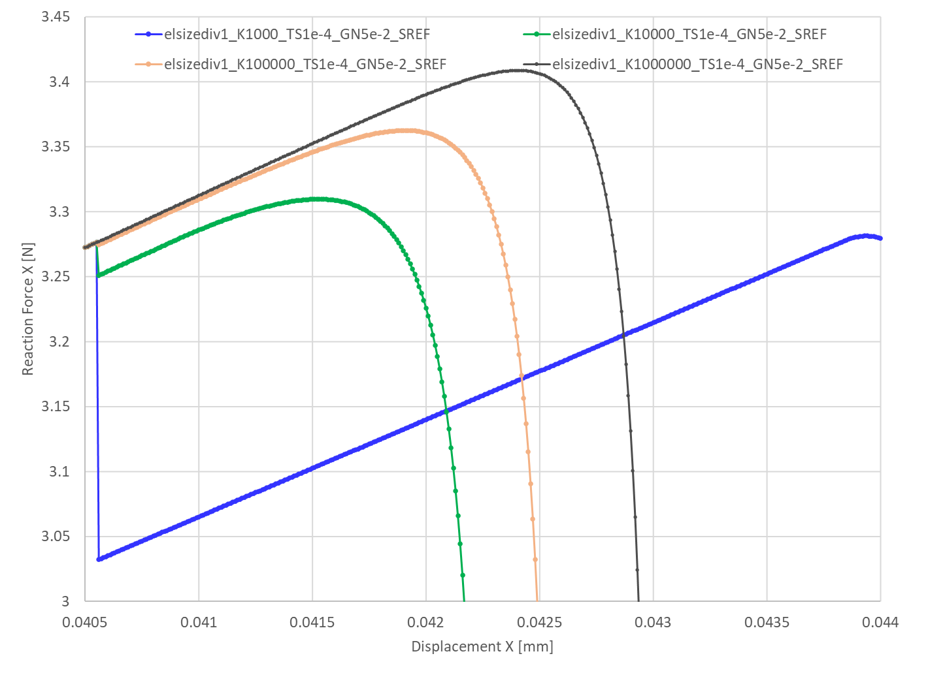
Stiffness K analysis
The cohesive element stiffness K can have a considerable effect of the macro behavior of the model.
A low K with respect to the stiffness to the surrounding volume elements will cause a load drop after the addition of the cohesive element and the energy dissipated by the system will increase.
A K convergence analysis is required to find the smallest value of K that provides a converged solution.

Slide 22
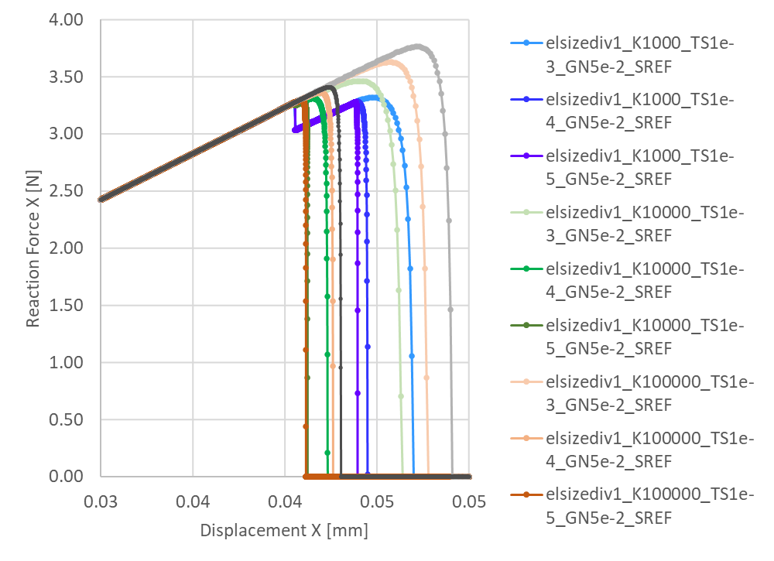
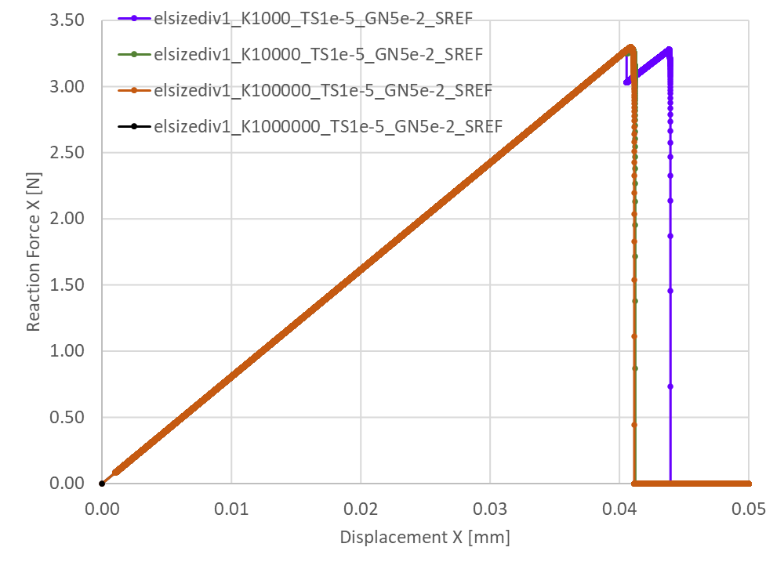
Convergence
The curves converge with an increasing K and finer discretization of time

Slide 23
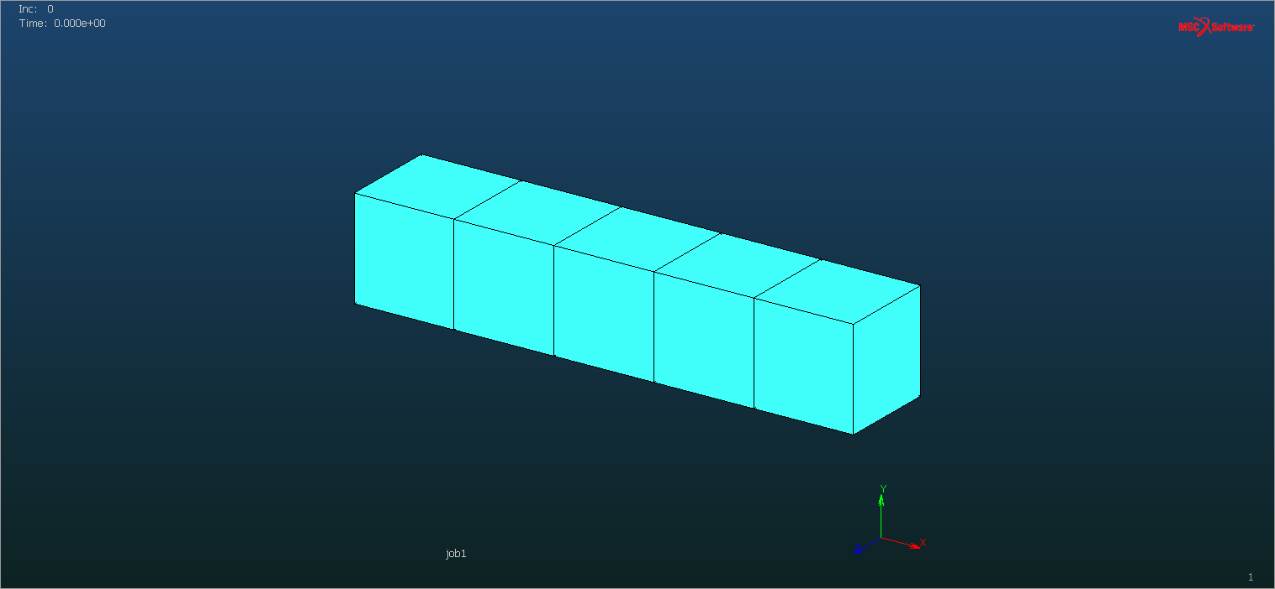
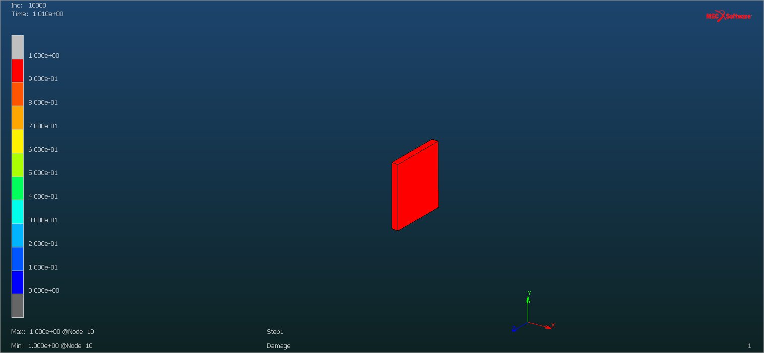
Mesh size analysis
elsizediv1
elsizediv2

Slide 24
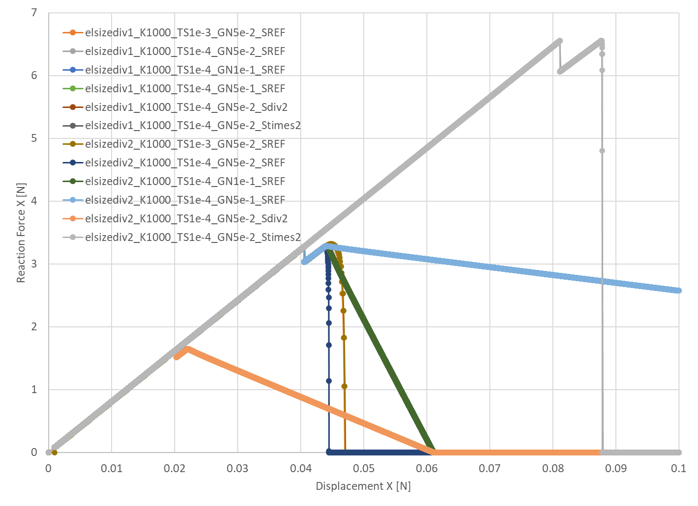
Mesh size comparison
Perfect superposition of curves for two different element sizes
Mesh size did not influence the behavior of the cohesive zone model in this parameter sensitivity analysis.

Slide 25
Plate with a hole test case

Slide 26
Model generated by script
The model of the plate with a hole is generated by a python script develop for this end
It is possible to define:
Dimensions of the plate
Dimensions of the hole
Element size
Mesher algorithm
Material properties
Imposed displacement

Slide 27
Overlay quad mesher
Deletion + deletion from post file
No deletion of cohesive elements
Deletion of cohesive elements

Slide 28
Overlay quad mesher – material borders
Deletion + deletion from post file
No deletion of cohesive elements
Deletion of cohesive elements

Slide 29
Planar quad mesher
Deletion + deletion from post file
No deletion of cohesive elements
Deletion of cohesive elements

Slide 30
Planar quad mesher – material borders
Deletion + deletion from post file
No deletion of cohesive elements
Deletion of cohesive elements

Slide 31
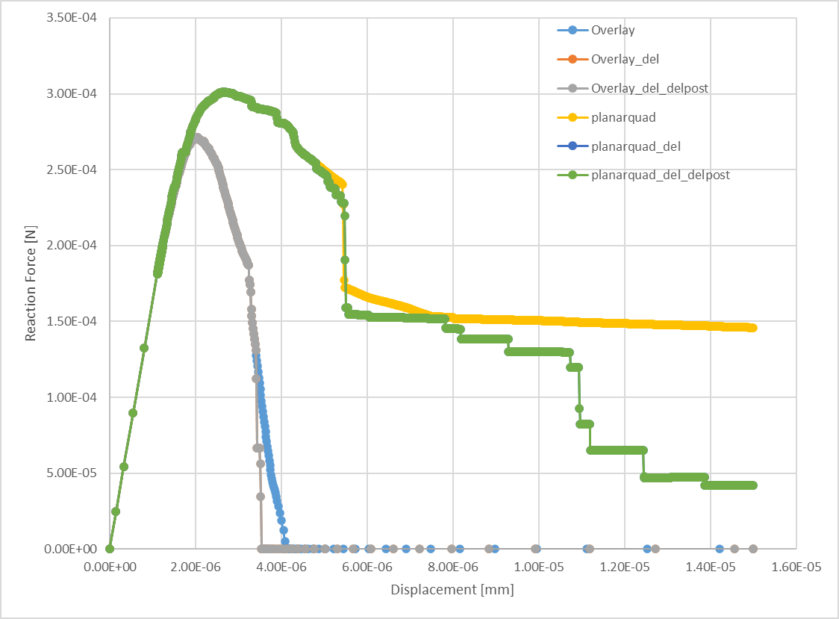
Comparison between quad meshers (elsize1e-3 TS1e-4)
Significant difference of behavior depending on mesh configuration:
Overlay: more structured mesh
Planarquad: less structured mesh
Check if solutions will converge by
Mesh refinement
Time discretization refinement
Answer: they do not

Slide 32
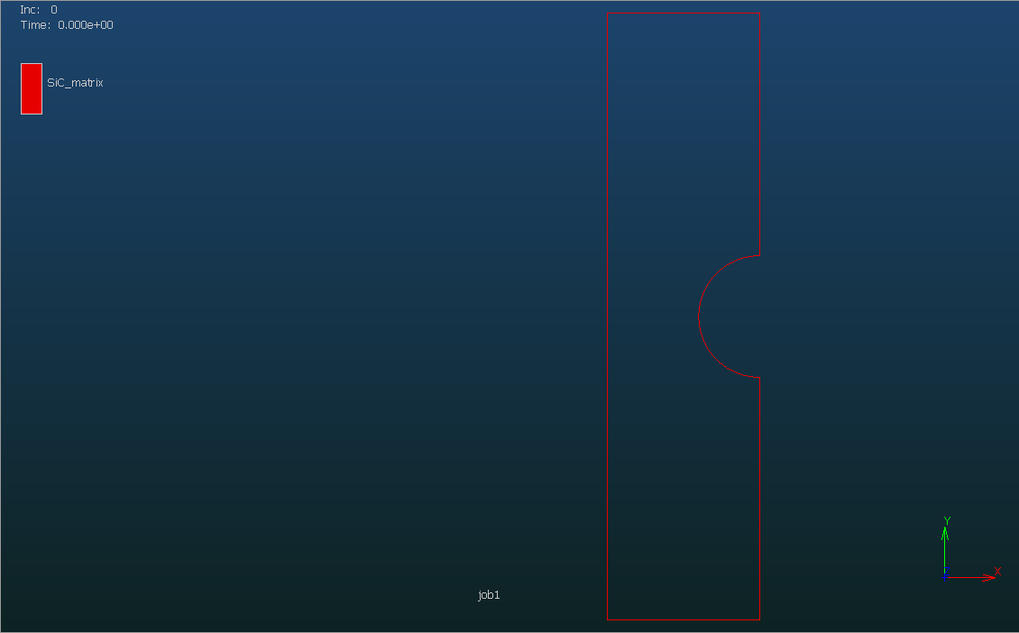
20x80 Table (intervals in the X direction x intervals in the Y direction)
Resulting table values are in average close to 10
PQ elsize3.75e-4 TS 1e-4
OV elsize3.75e-4 TS 1e-4

Slide 33
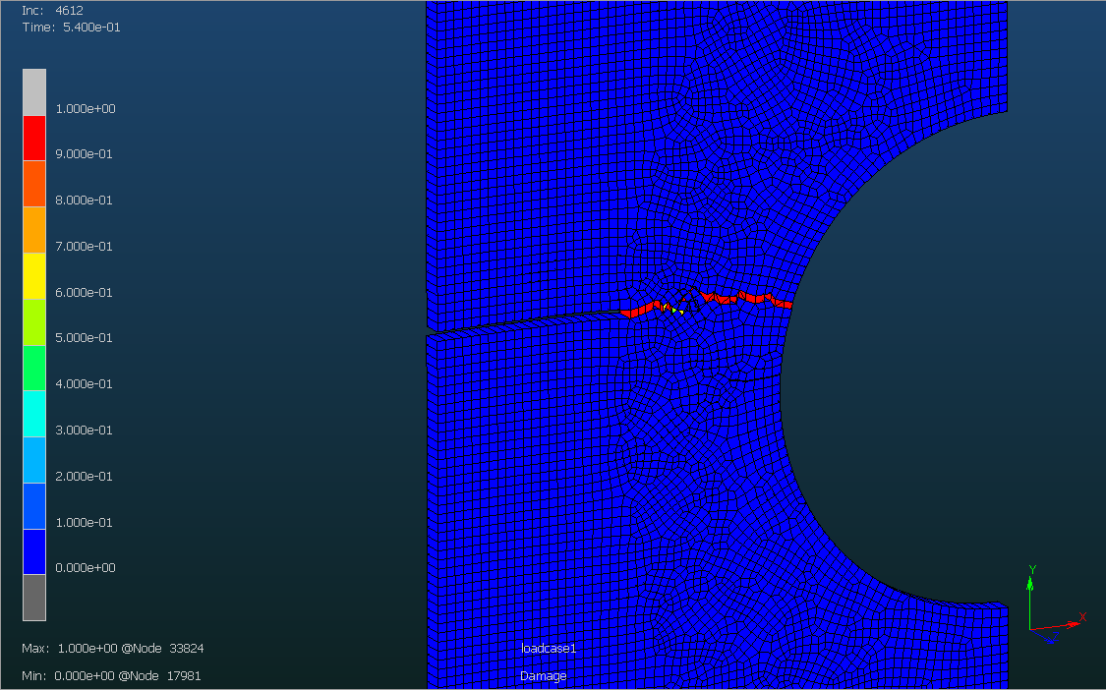
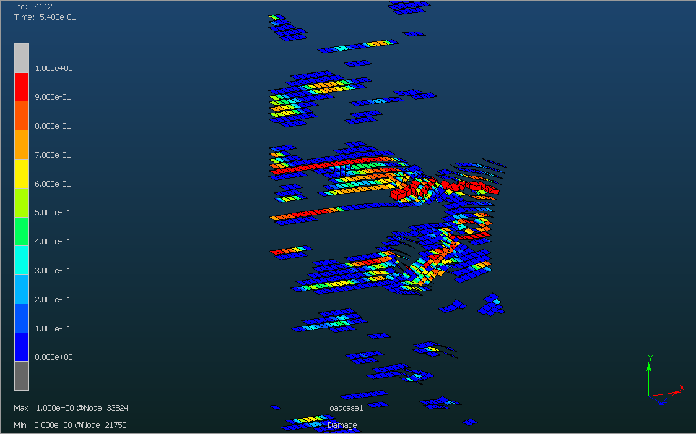
Mesh obtained by the planarquad mesher
elsize3.75e-4 TS1e-4
Damage: all elements
Damage: cohesive elements

Slide 34
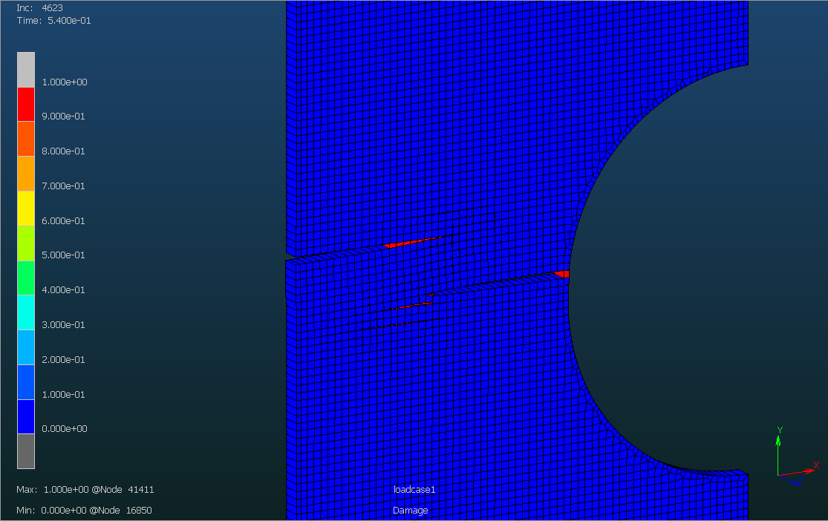
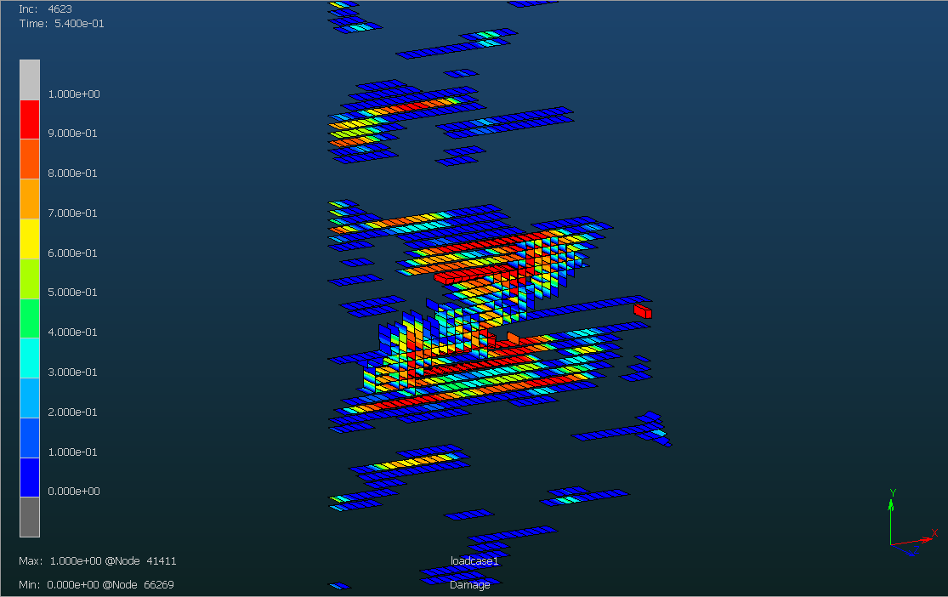
Mesh obtained by the overlay mesher
elsize3.75e-4 TS1e-4
Damage: all elements
Damage: cohesive elements

Slide 35
Reaction Force vs Displacement

Slide 36
Reason of differences between structured mesh and unstructured mesh

Slide 37
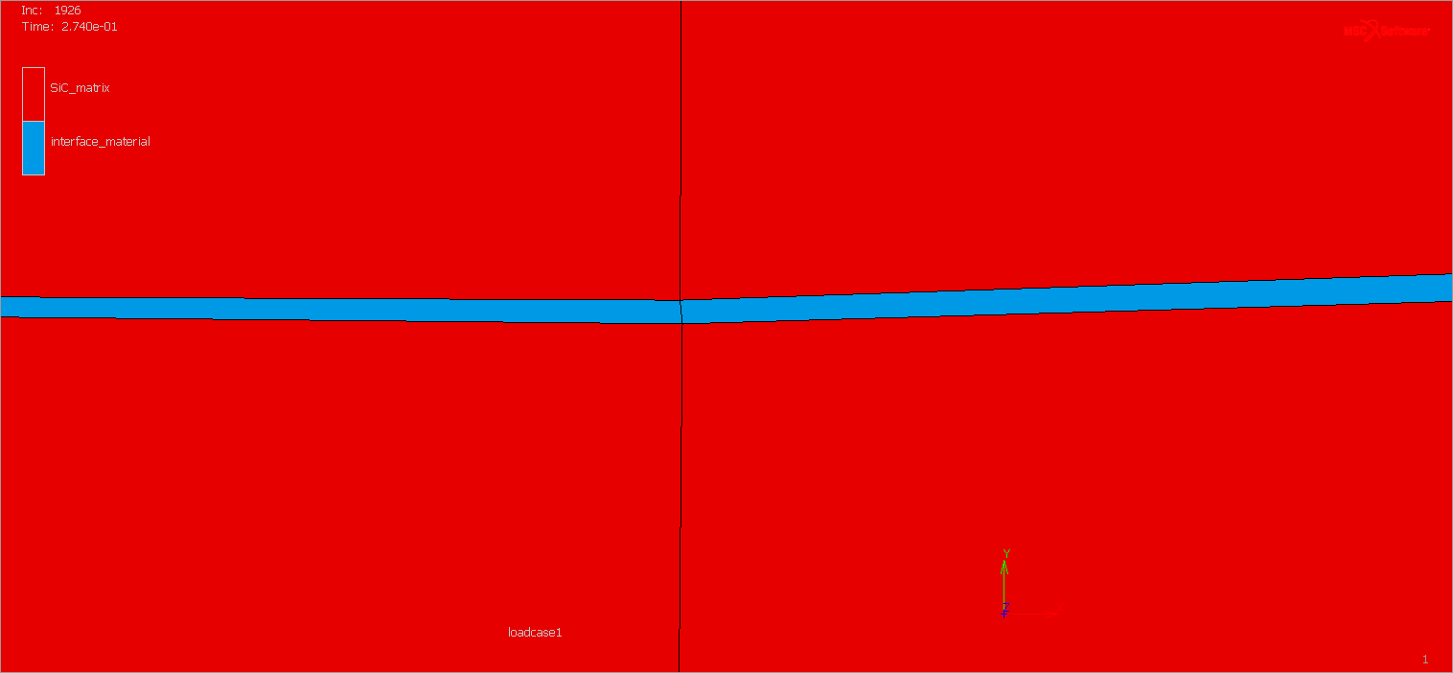
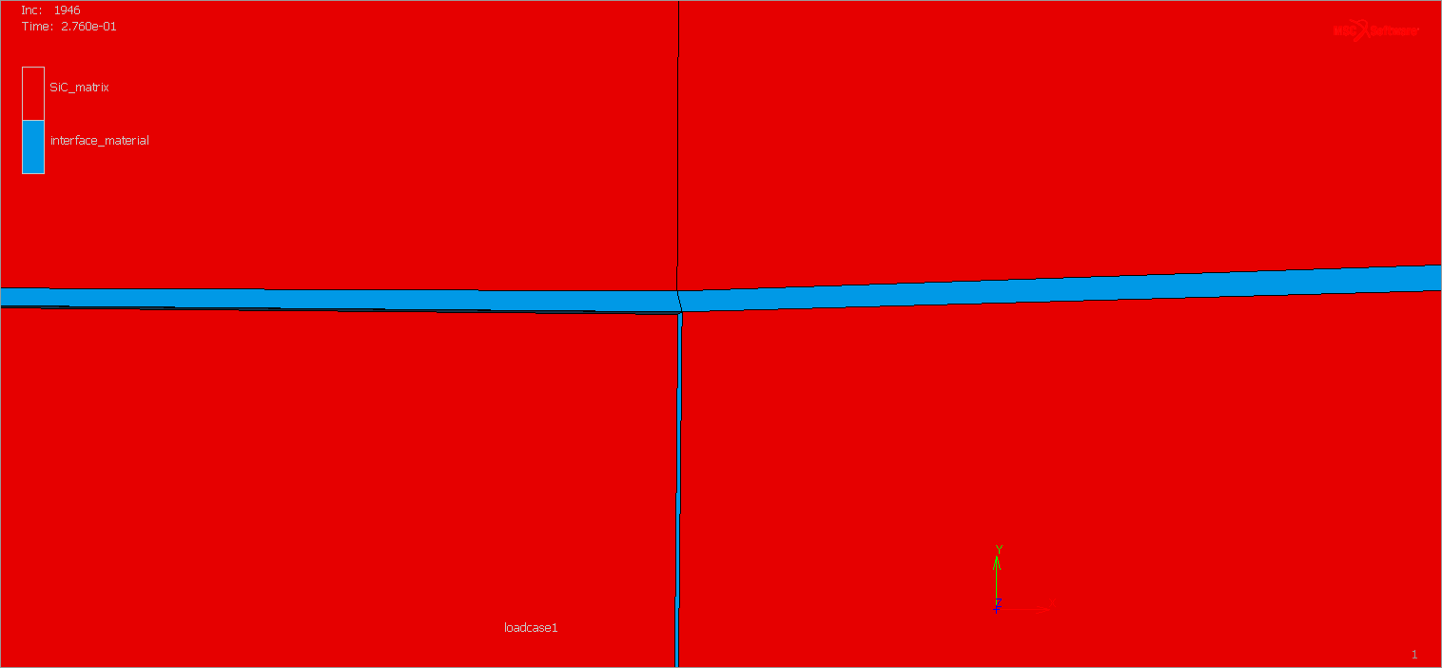
Crack branching causes problem
The mesh split algorithm is not capable of updating the connectivity of existing cohesive elements
Expected configuration:
Obtained configuration:

Slide 38
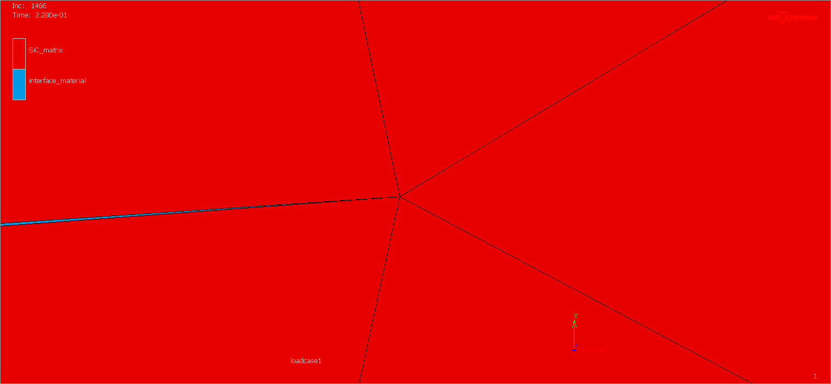
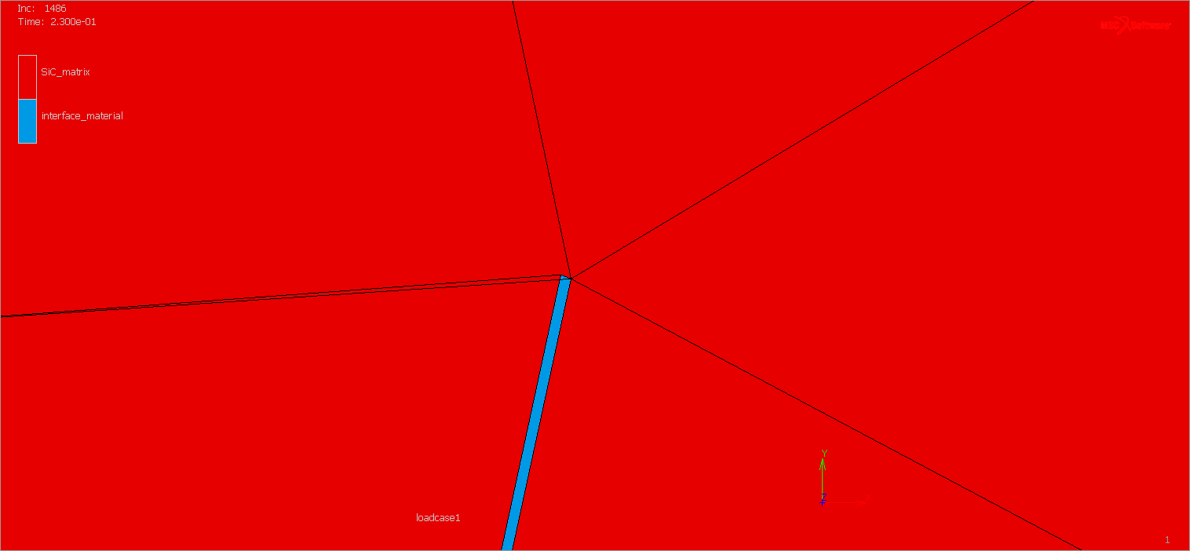
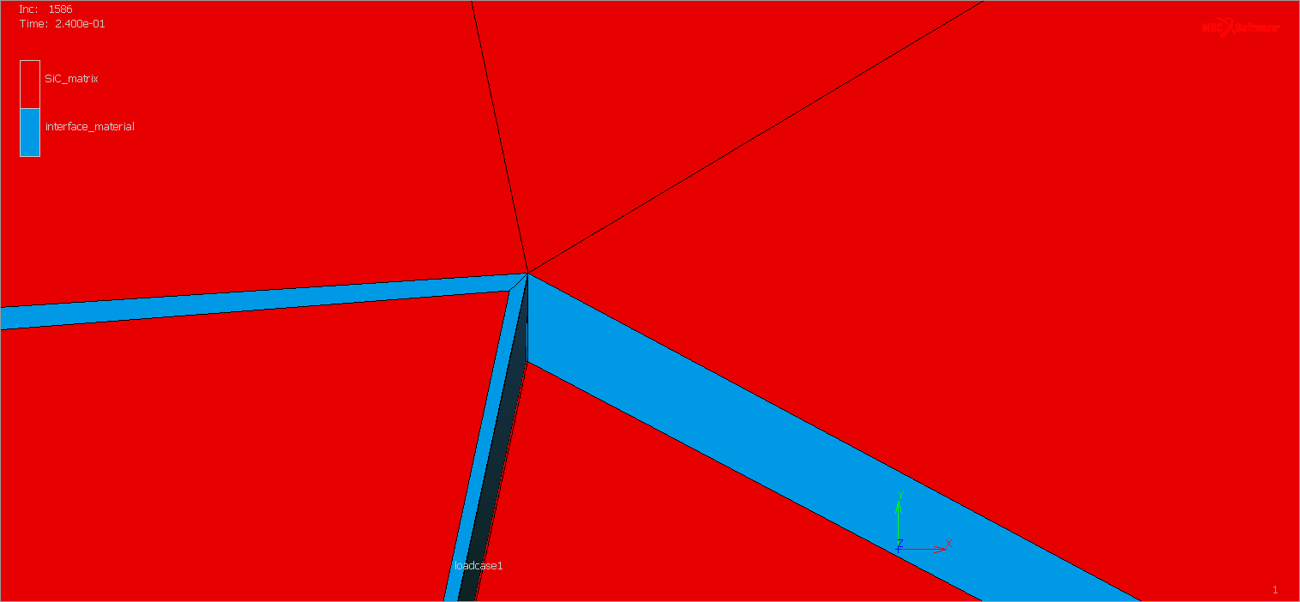
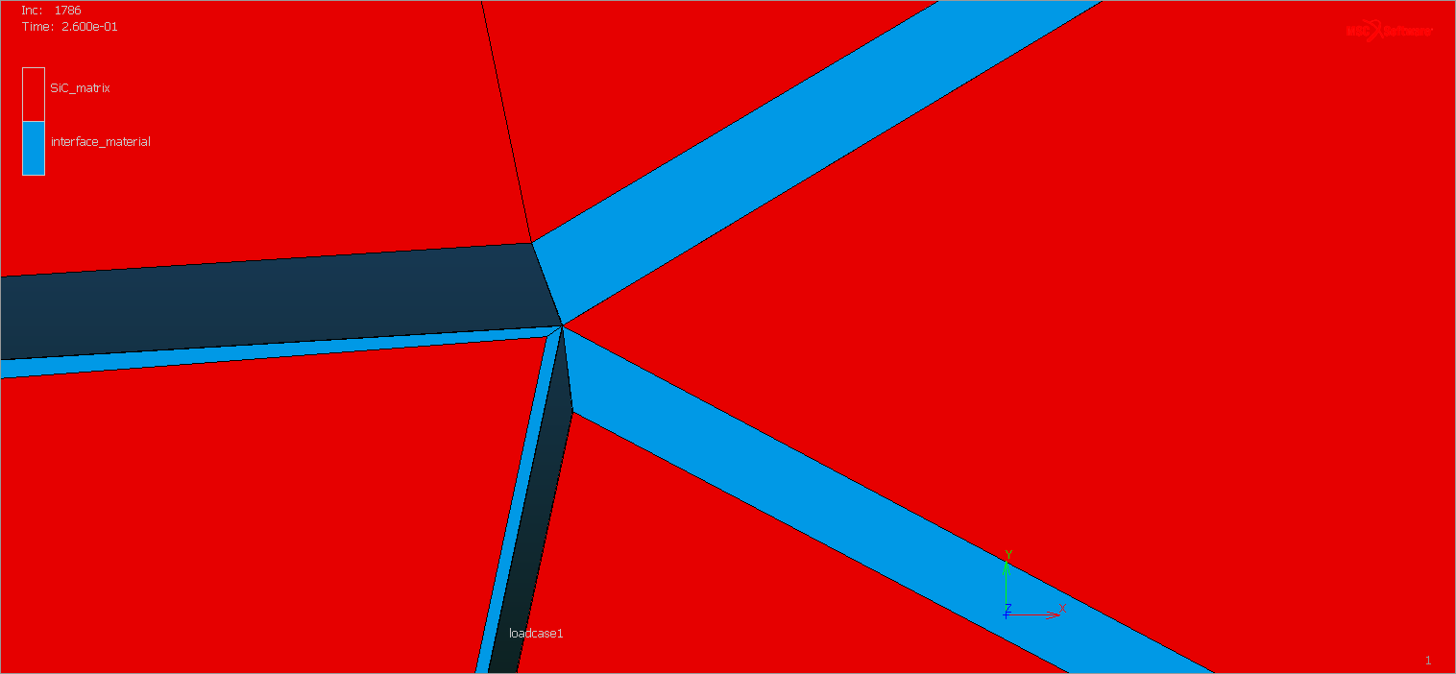
Another example:

Slide 39
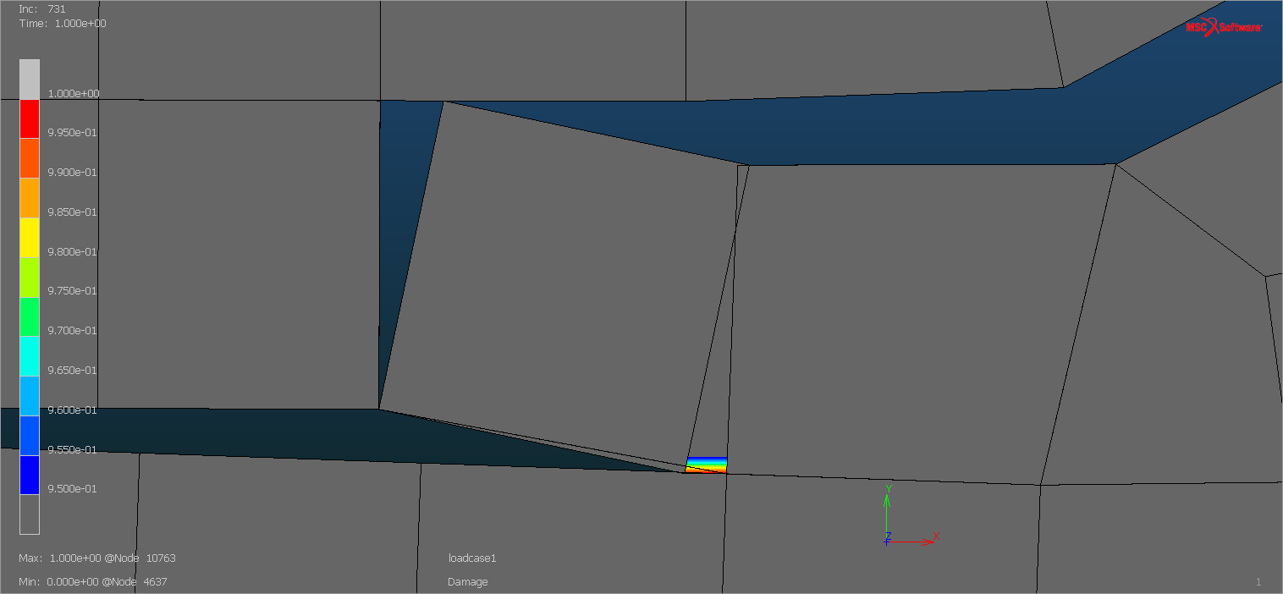
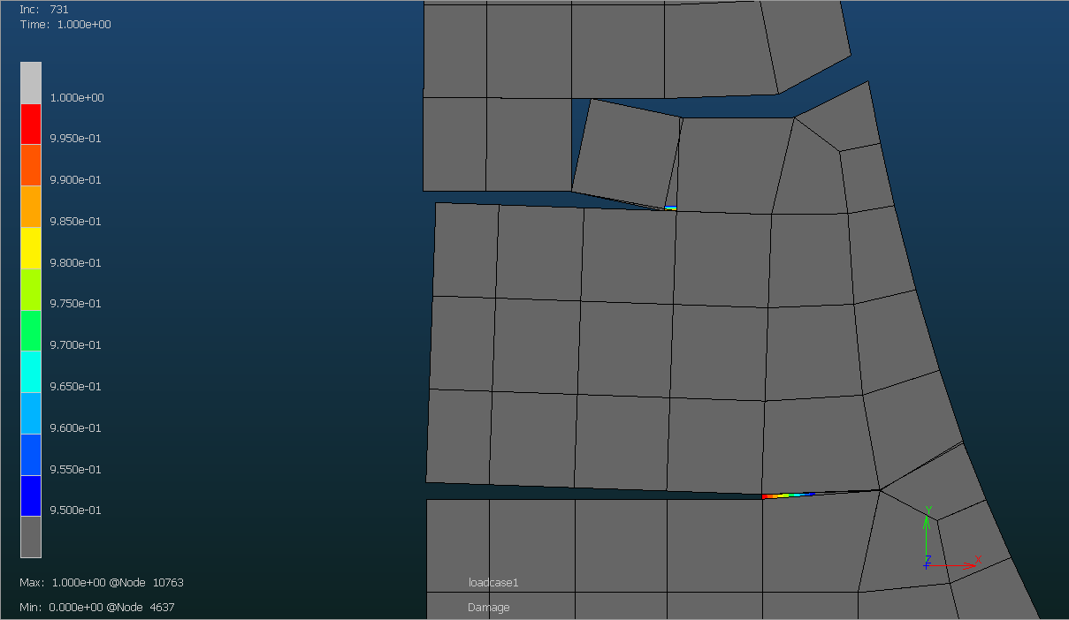
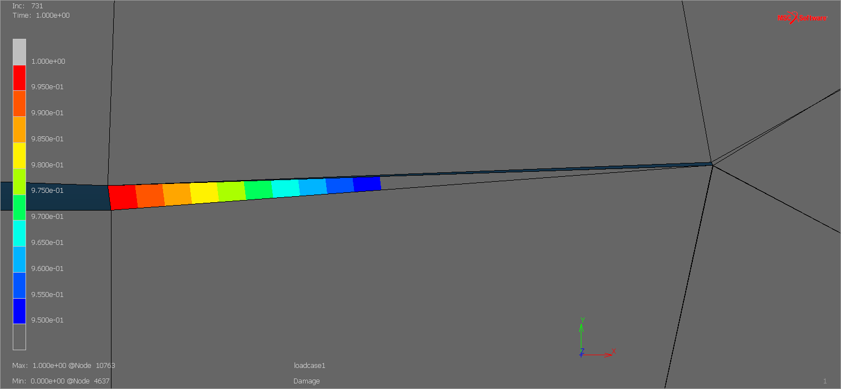
Consequences of crack branching problems
“Negative” separations on one side. Damage does not evolve as it should
Mesh split bug. These nodes have remained connected.
Cohesive element connected to the wrong nodes on one side. Damage does not evolve as it should

Slide 40
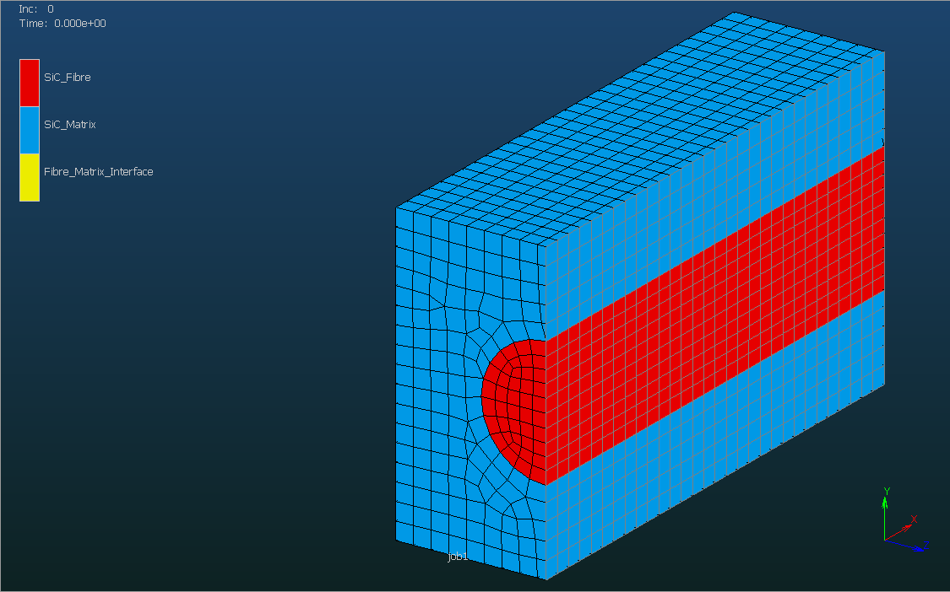
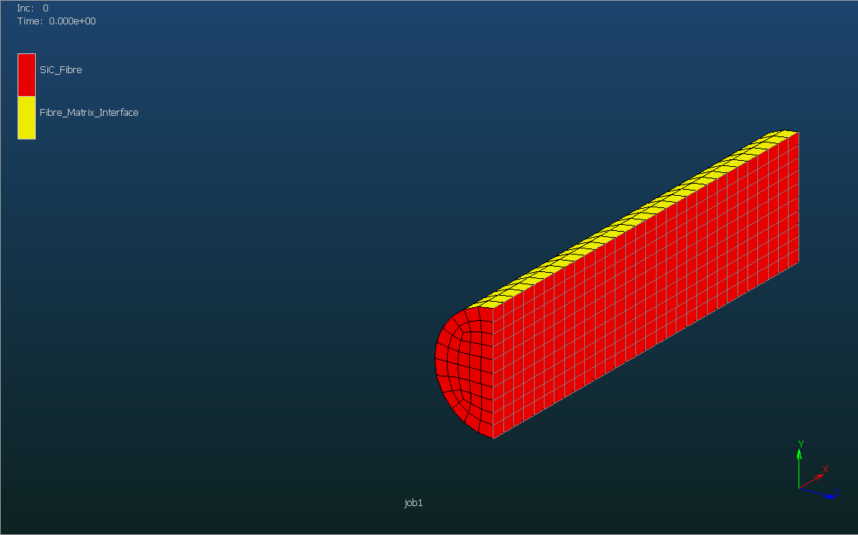
Could mesh split + insertion of cohesive element work for the fibers?
One single fiber with mesh split depending on table and weak link at x=LX/2

Slide 41
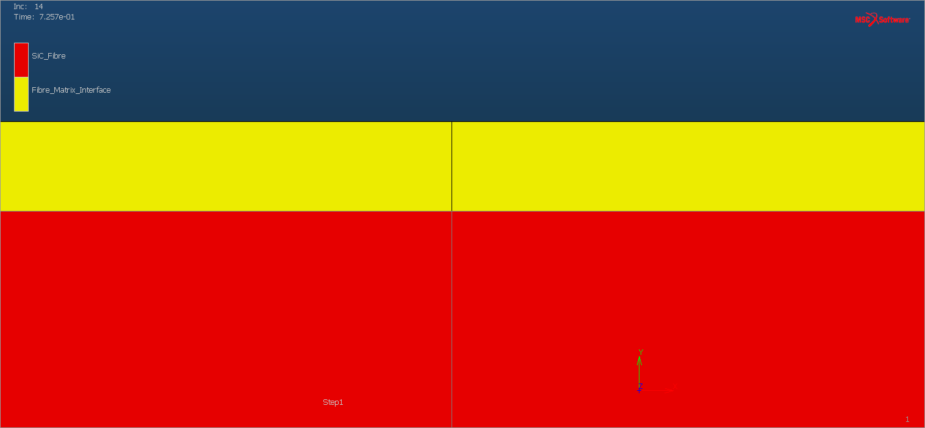
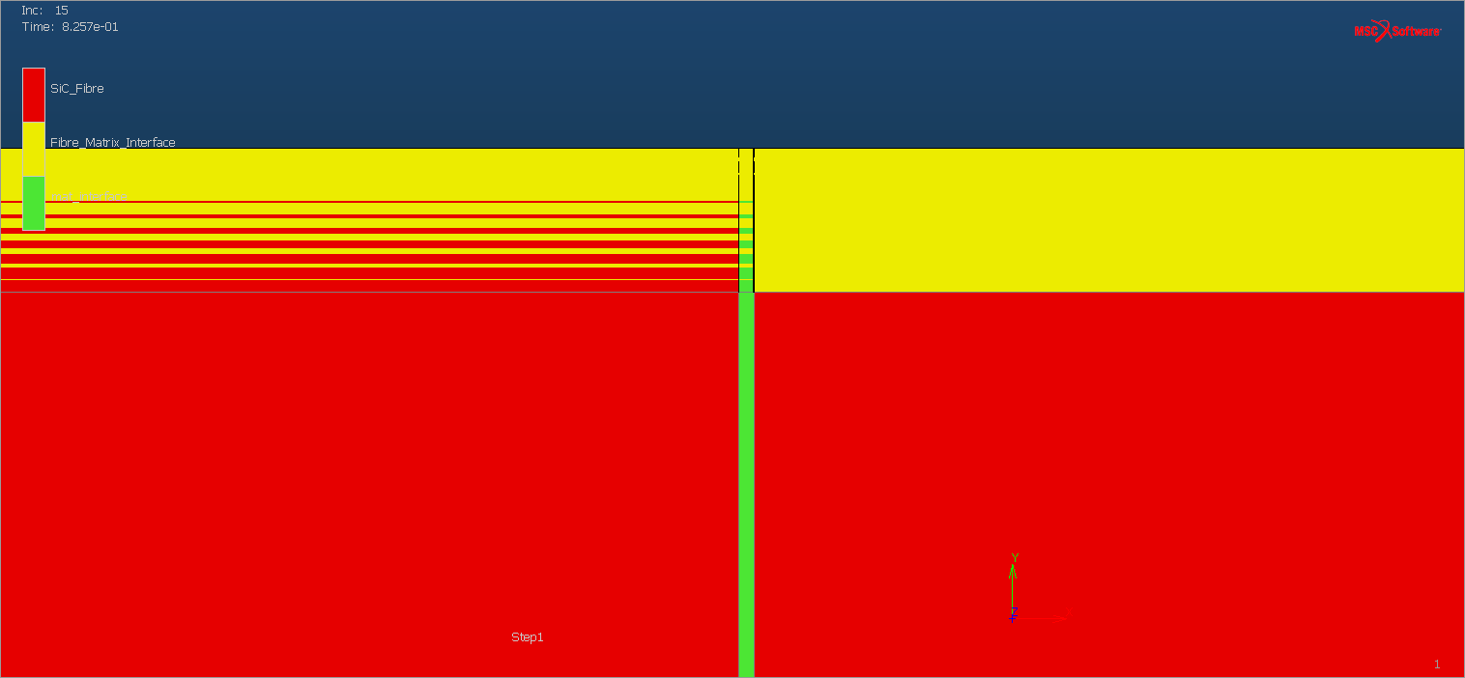
Could mesh split + insertion of cohesive element work for the fibers?
Before mesh split index = 1
After mesh split + insertion of cohesive elements

Slide 42
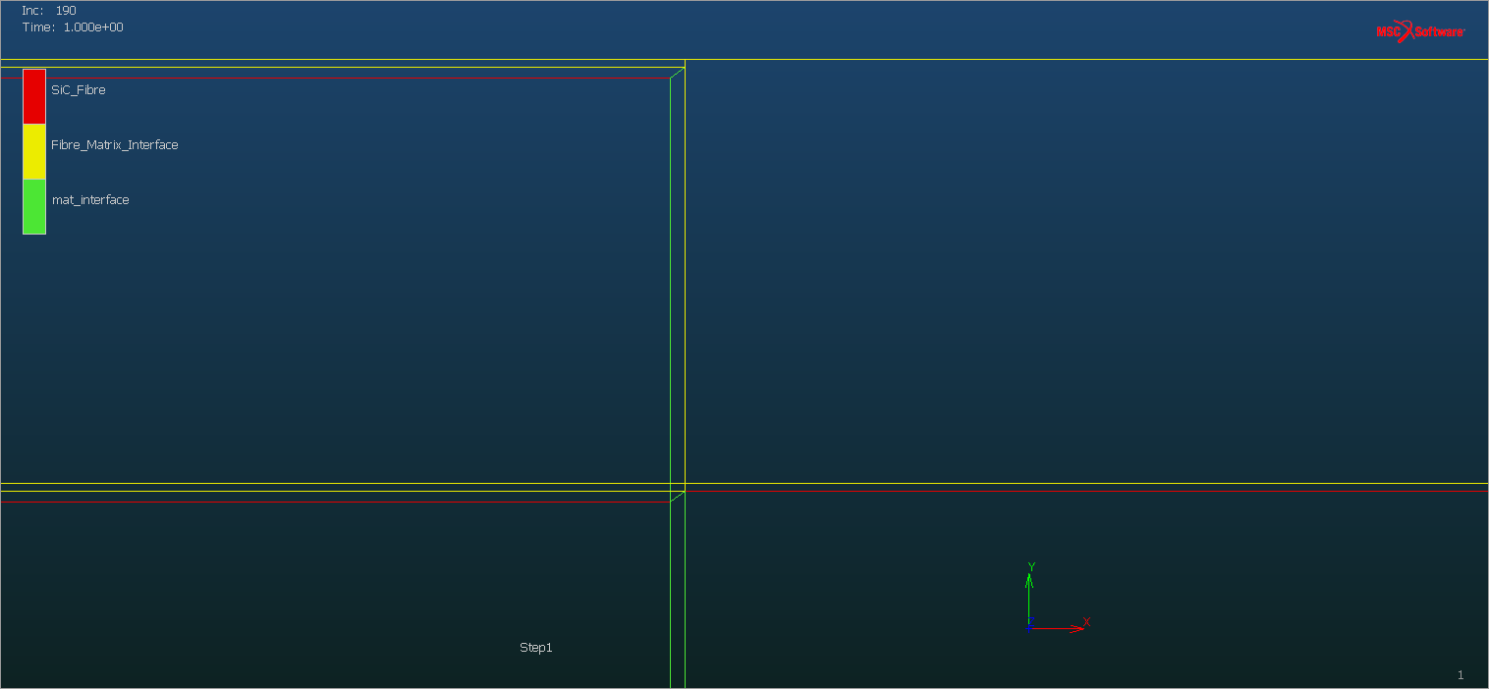
Crack branching occurs
Expected configuration:
Matrix
Fibre/matrix interface
Fibre
Fibre
Cohesive element due to crack
Obtained configuration:
Matrix
Fibre/matrix interface
Fibre
Fibre
Cohesive element due to crack

Slide 43
CZM conclusions
Marc’s mesh split algorithm works well when no crack branching occurs
When crack branching occurs, the connectivity of the already exiting cohesive elements are not updated to match the solid elements nodes that they should be connected to
This can cause nodes that should be split to remain connected
Wrong damage evolution on one of the sides of the cohesive element due to bad connectivity
Using a 1 Gauss Point criterion to delete the cohesive element at a given damage value can work to some extent to go around this problem, but it is not an ideal solution
It is possible to implement Marc subroutines concerning mesh split, but I could become dangerous
All cases of branching would have to be considered, which can be tricky in 3D

Slide 44
Continuous Damage Model

Slide 45
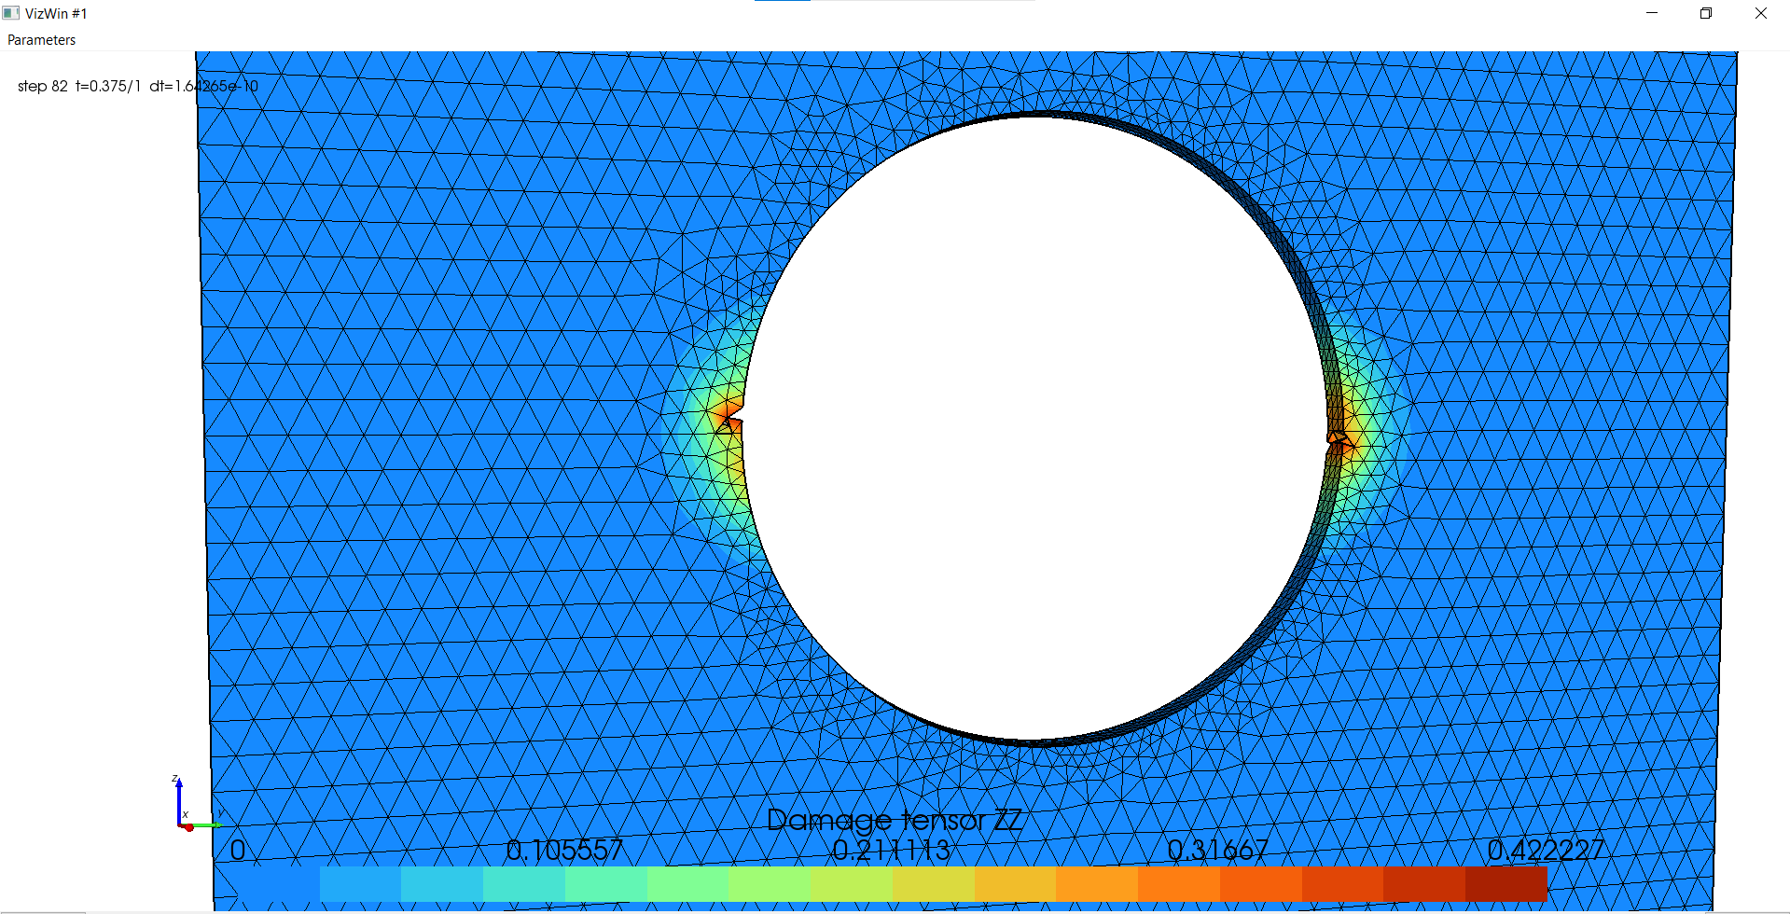
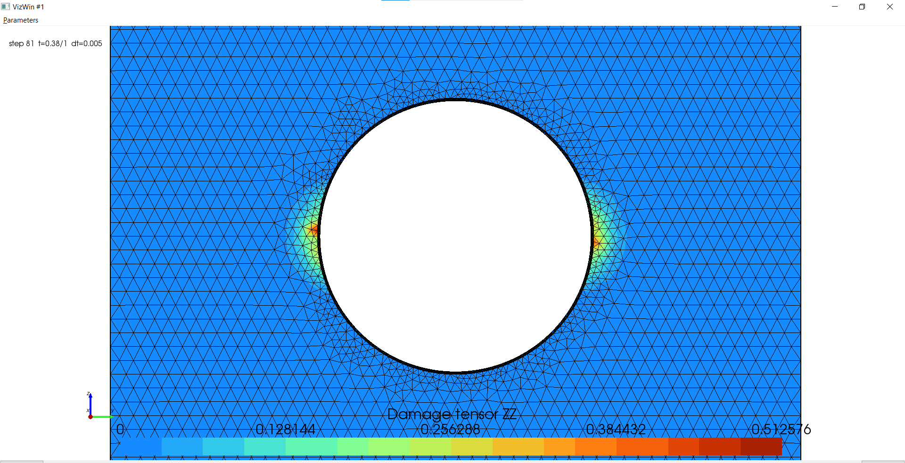
Attempt to use existing CDM models of Metafor to model CMC’s
Using the plate with a hole test case
Attempts to use Lemaitre Isotropic and Lemaitre Anisotropic, with and without element deletion
Using CMC-like material parameters (low equivalent plastic strain threshold and elevated damage constants)
Convergence problems
Need to take a step back, use a simpler geometry first

Slide 46
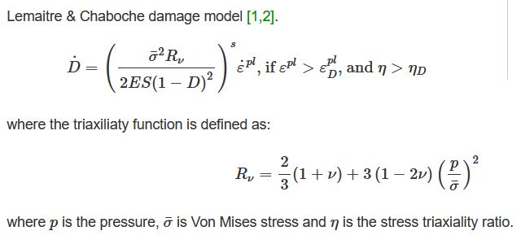
Monoelement model
Objective: have a pseudo-elastic with damage behavior by CMC-like parameters

Slide 47
Pseudo-elastic behavior
materset.define(1, ContinuousDamageEvpIsoHHypoMaterial)
materset(1).put(MASS_DENSITY, 3.5e-8)
materset(1).put(ELASTIC_MODULUS, 404000.0)
materset(1).put(POISSON_RATIO, 0.16)
materset(1).put(YIELD_NUM, 2)
materset(1).put(DAMAGE_NUM, 3)
materset(1).put(DAMAGE_INIT, 0.)
materset(1).put(DAMAGE_MAX, 0.99)
materset(1).put(TYPE_INTEG, 0)
materset(1).put(DAMAGE_MCCE, 1.0)
materiallawset.define(2, LinearIsotropicHardening)
materiallawset(2).put(IH_SIGEL, 4040.0)
materiallawset(2).put(IH_H, 0.0)
materiallawset.define(3, LemaitreChabocheContinuousDamage)
materiallawset(3).put(LEMAITRE_YOUNG, 404000.0)
materiallawset(3).put(LEMAITRE_NU, 0.16)
materiallawset(3).put(LEMAITRE_SMALL_S, 1.0)
materiallawset(3).put(LEMAITRE_BIG_S, 0.5)
materiallawset(3).put(LEMAITRE_EPL_THRESHOLD, 0.000000000000001)
materiallawset(3).put(LEMAITRE_TRIAX_THRESHOLD, 0.01)

Slide 48
Pseudo-elastic behavior
materset.define(1, ContinuousDamageEvpIsoHHypoMaterial)
materset(1).put(MASS_DENSITY, 3.5e-8)
materset(1).put(ELASTIC_MODULUS, 404000.0)
materset(1).put(POISSON_RATIO, 0.16)
materset(1).put(YIELD_NUM, 2)
materset(1).put(DAMAGE_NUM, 3)
materset(1).put(DAMAGE_INIT, 0.)
materset(1).put(DAMAGE_MAX, 0.99)
materset(1).put(TYPE_INTEG, 0)
materset(1).put(DAMAGE_MCCE, 1.0)
materiallawset.define(2, LinearIsotropicHardening)
materiallawset(2).put(IH_SIGEL, 4040.0)
materiallawset(2).put(IH_H, 100000000.0)
materiallawset.define(3, LemaitreChabocheContinuousDamage)
materiallawset(3).put(LEMAITRE_YOUNG, 404000.0)
materiallawset(3).put(LEMAITRE_NU, 0.16)
materiallawset(3).put(LEMAITRE_SMALL_S, 1.3)
materiallawset(3).put(LEMAITRE_BIG_S, 0.015)
materiallawset(3).put(LEMAITRE_EPL_THRESHOLD, 0.000000000000001)
materiallawset(3).put(LEMAITRE_TRIAX_THRESHOLD, 0.01)
It is possible to achieve a pseudo-elastic behavior by combining a very elevated hardening modulus, a very low equivalent plastic strain and adapting the damage parameters

Slide 49
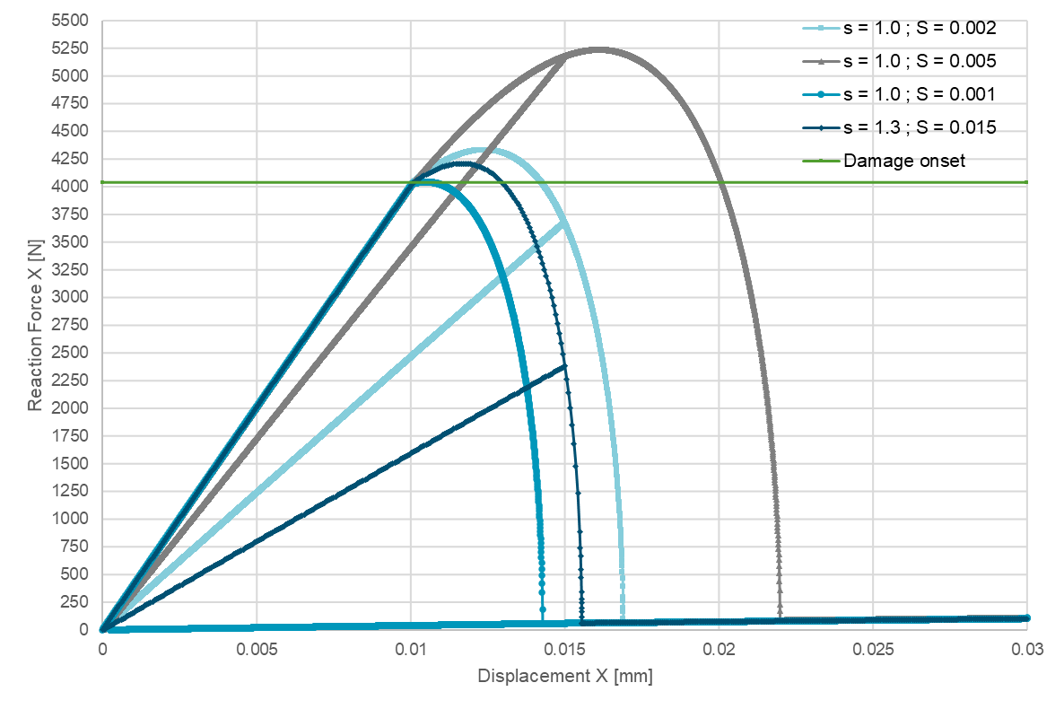
Comparison
Different sets of damage parameters
Problem:
As a consequence of the damage model that depends on the equivalent plastic strain and the elevated hardening modulus, the element keeps increasing its load bearing capacity even after the moment where damaging starts (in this case the Yield Stress)
This would not be the case with a damageable elastic material

Slide 50
Convergence issues on a plate with a hole model
When using sets of parameters that were tested on the monoelement test case on the plate with a hole model
No convergence
Try to use material properties from Metafor test cases as a starting point and adapt parameters to obtain a damageable pseudo-elastic behavior

Slide 51
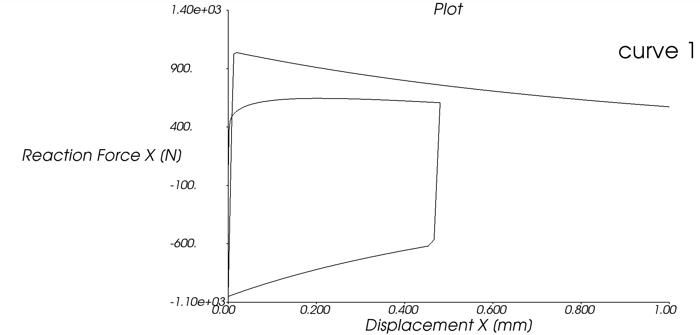
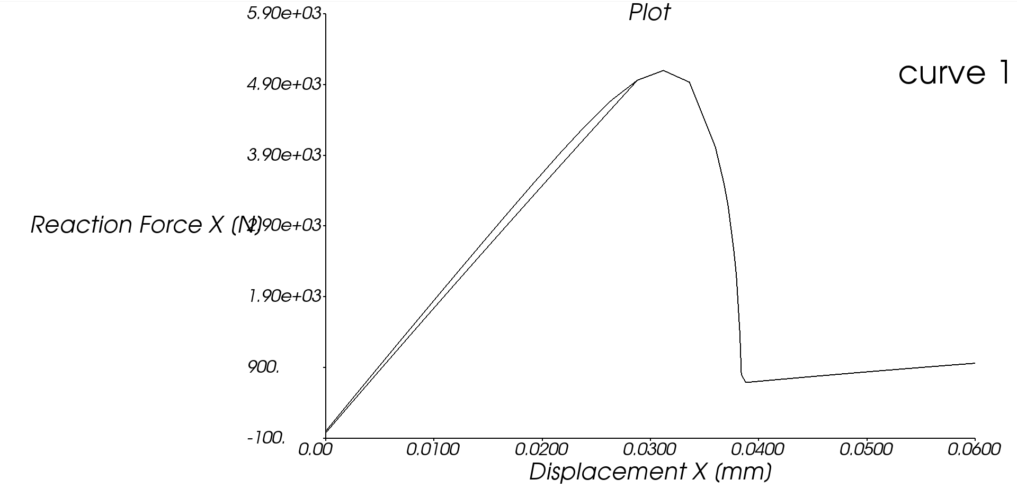
Monoelement model – Lemaitre isotropic
Material parameters taken from blanking.py
Reducing equivalent plastic strain threshold and increasing the hardening
Reference
IH_B = 6.880672573541729e2
LEMAITRE_EPL_THRESHOLD = 0.3141
Modified 2
IH_B = 1500.0e2
LEMAITRE_EPL_THRESHOLD = 0.0000005

Slide 52
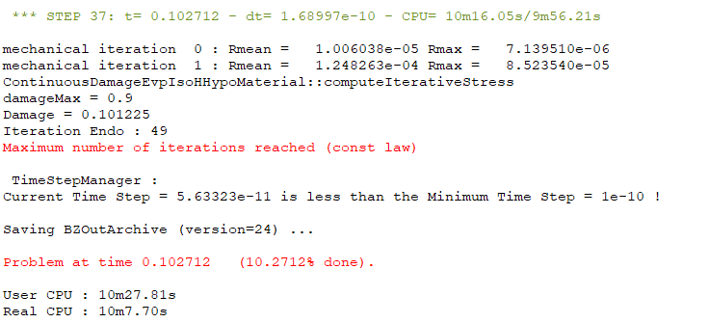
Convergence problems in plate with a hole model
Lemaitre-Chaboche isotropic continuous damage

Slide 53
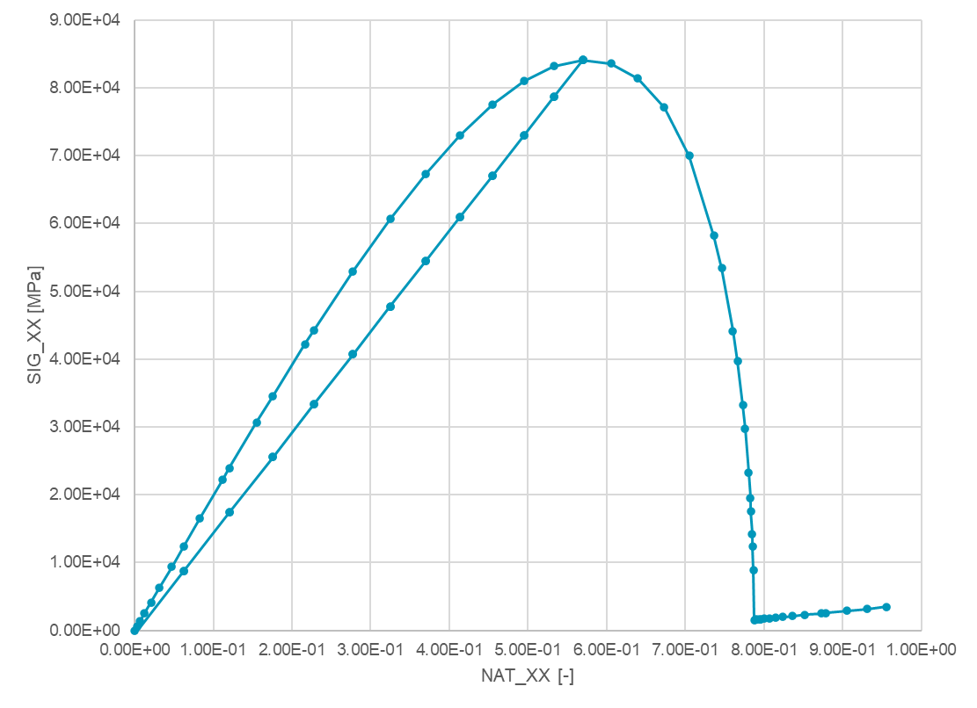
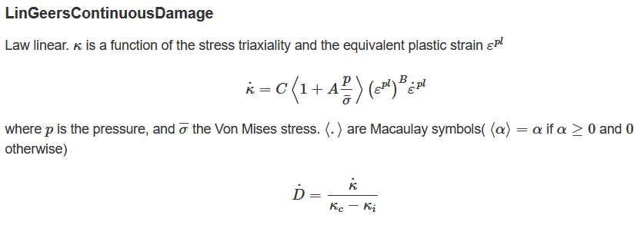
Geers isotropic continuous damage
Properties adapted from Geers test cases
Reduced EPL threshold and increased the hardening modulus

Slide 54
Convergence issues in plate with a hole model
Geers isotropic continuous damage

Slide 55
Conclusions
Using CDM’s that depend on the equivalent plastic strain to model fragile, ceramic materials pushes the material and damage model to the limit
On a simple, small model it is still possible to converge
This is not the case for larger, more complex models
Need to implement a model adapted to damageable elastic materials
Revisit models that were listed on the CDM review as well as new model suggested by Romain

